Slide 1
Class of 2021 Year 11 Parents and carers information
Nottingham free school

Slide 2
thank you!

Slide 3
Goals, not grades

Slide 4
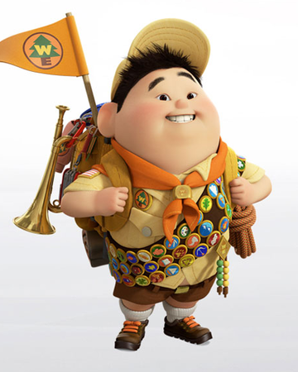
Taking Action! All students need to do is…
Work hard in school (classwork)
Work hard at home (homework)
Be on time

Slide 5
A balanced workload is key!

Slide 6
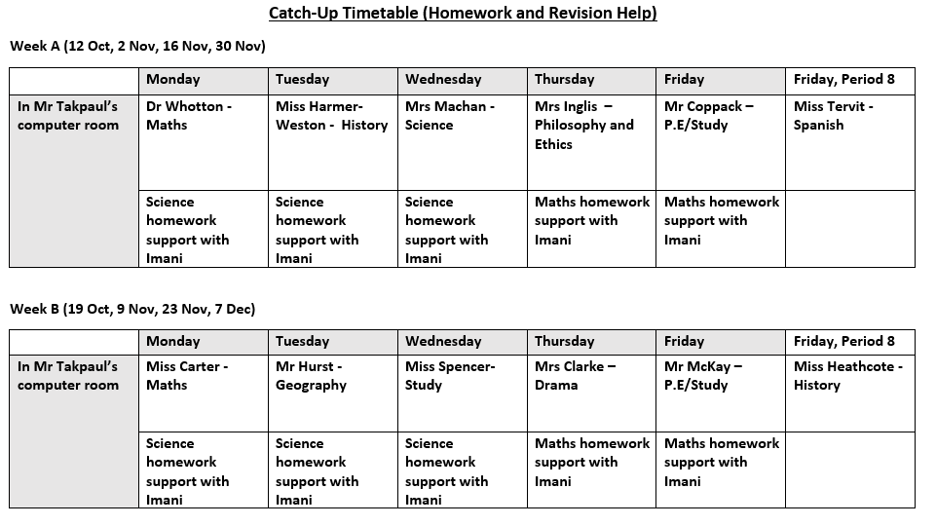
How can we help with homework and revision?
Before school CATCH-UP sessions
Monday-Friday 0930am-1025am
Subject teachers helping
Booking form is online… Book your child a place today! ☺

Slide 7
Different approaches
Activity? | How are we doing it this year?
Mock exams | Reduced number of mock exams in the hall or access room In-class tests at the end of a topic Some mock exams in February and March
Parents’ Evening | Tutors to do video, or phone, call Tutor provides a summary of feedback from teachers
Absences | If students are self-isolating – all work set on Microsoft Teams If year 11 could not come into school for a period of time – timetabled lessons will happen online (a mixture of live and pre-recorded lessons with activities to complete and submit by end of the lesson)

Slide 8
GCSE Changes… The story so far
Teachers have adjusted lessons if Ofqual has confirmed changes to GCSE assessments in 2021
Our priority is to provide a wholesome education
https://schoolsweek.co.uk/exams-2021-all-the-gcse-changes-subject-by-subject/

Slide 9
Trialling online lessons – Friday 16 October at 9am
Students log on to Microsoft Teams and go to their class at 9am.
Any live lessons will see a teacher present presentation slides with live voice over.
Pre-recorded lessons are uploaded at 9am.
Students will be given an online piece of work to do that is submitted within the 50 minute period.
Option Block A – Usually period 7 on Fridays
Miss Tervit’s Spanish class
Miss Heathcote’s history class
Mr Hurst’s geography class
Mr Landa’s study class (to do maths)

Slide 10
Last Friday of this half term (23rd October)
Year 11 will finish at 2pm on the last Friday of this half term
Special lunch & assembly

Slide 11
Please contact us if you need to! ☺
contact@nottinghamfreeschool.co.uk
jtomasevic@nottinghamfreeschool.co.uk

