Slide 1

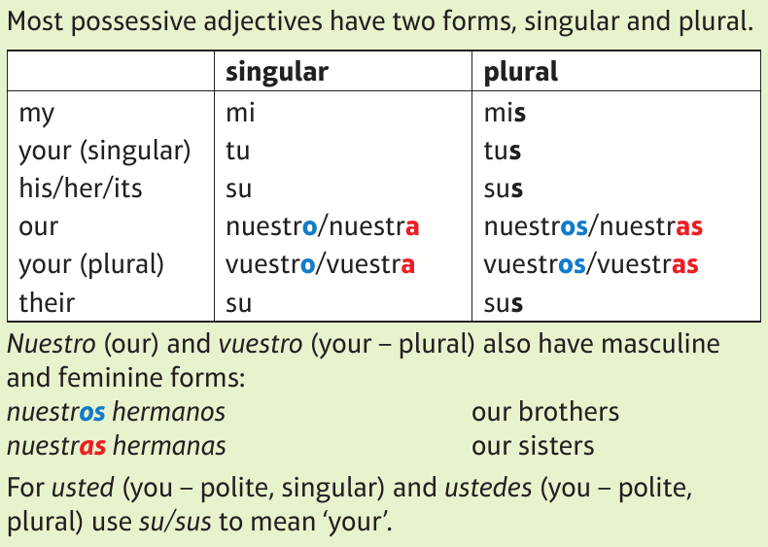
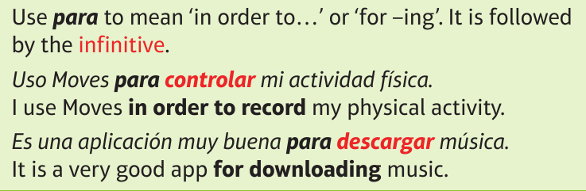
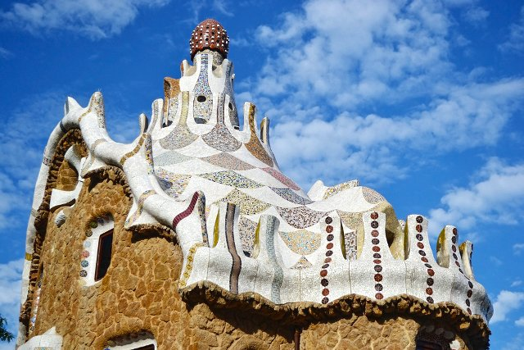

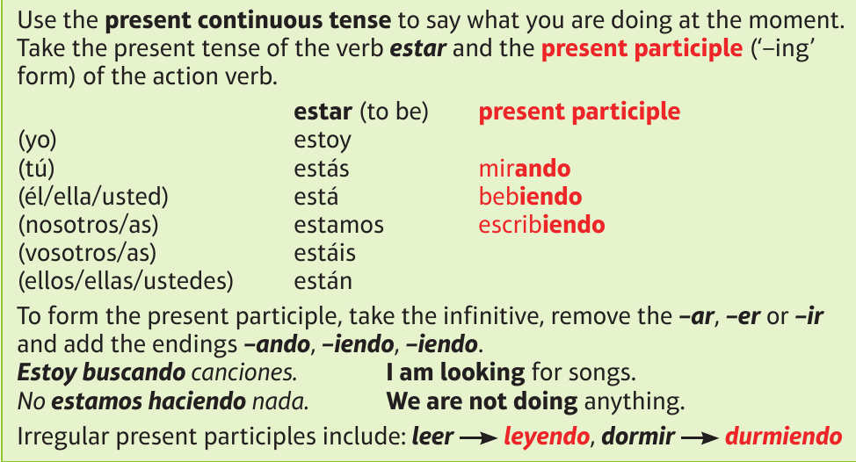
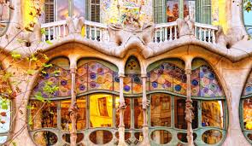
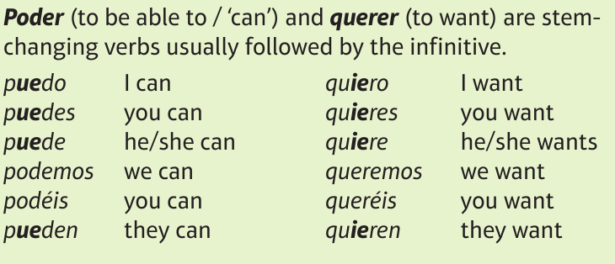

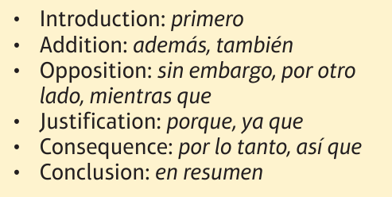
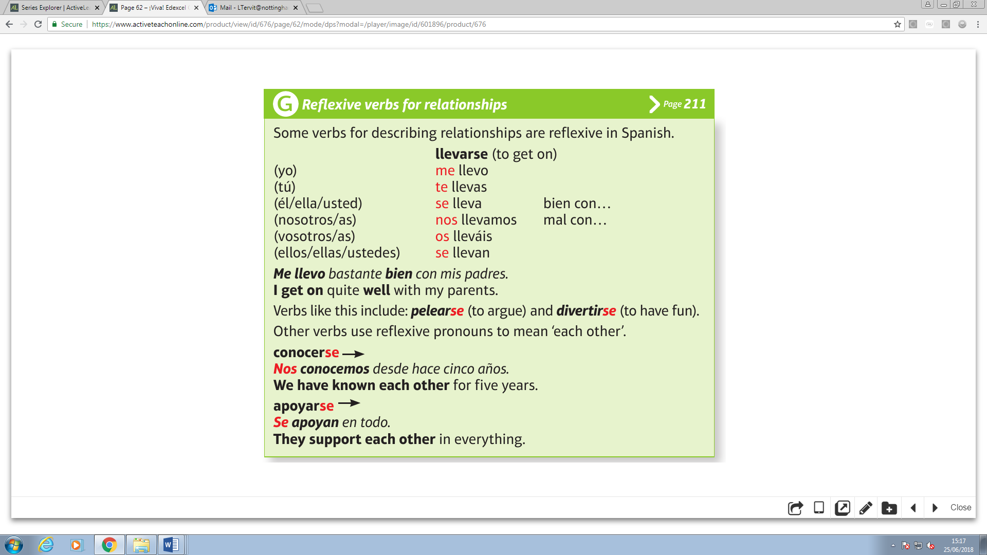
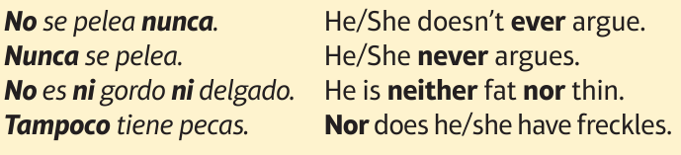

Year 9 Homework
Knowledge Organiser
Autumn Term 1
Spanish
Modal verbs & present continuous – https://quizlet.com/_5kxhyx
La magnífica arquitectura ‘art nouveau’ de Antoni Gaudi, considerado una de las figuras claves del movimiento modernista

Slide 2
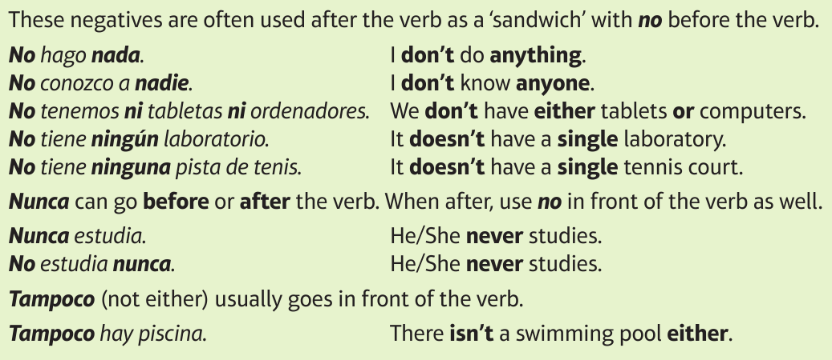
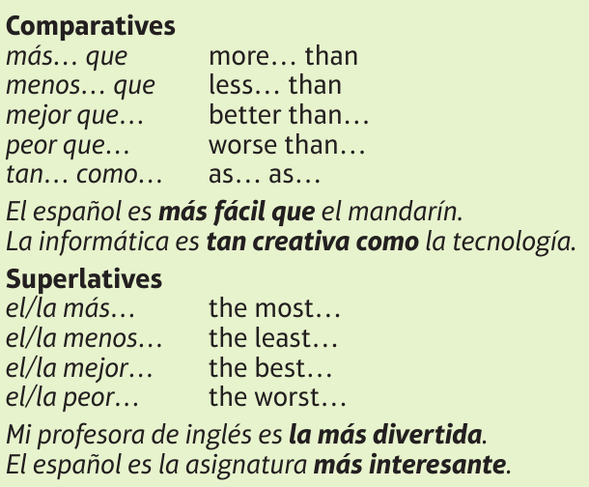
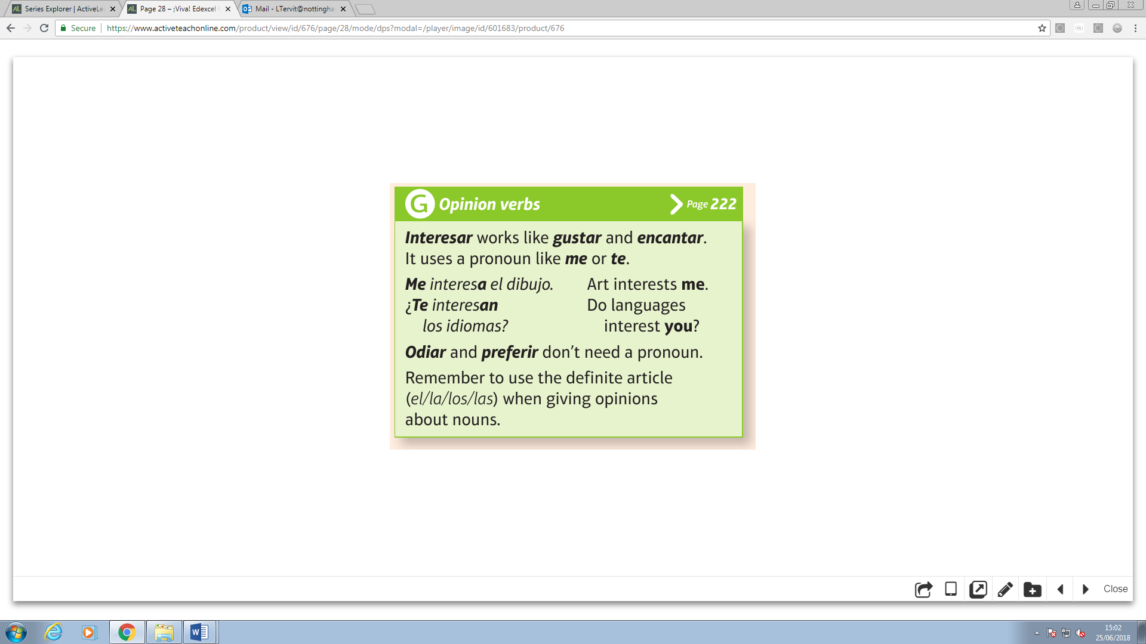
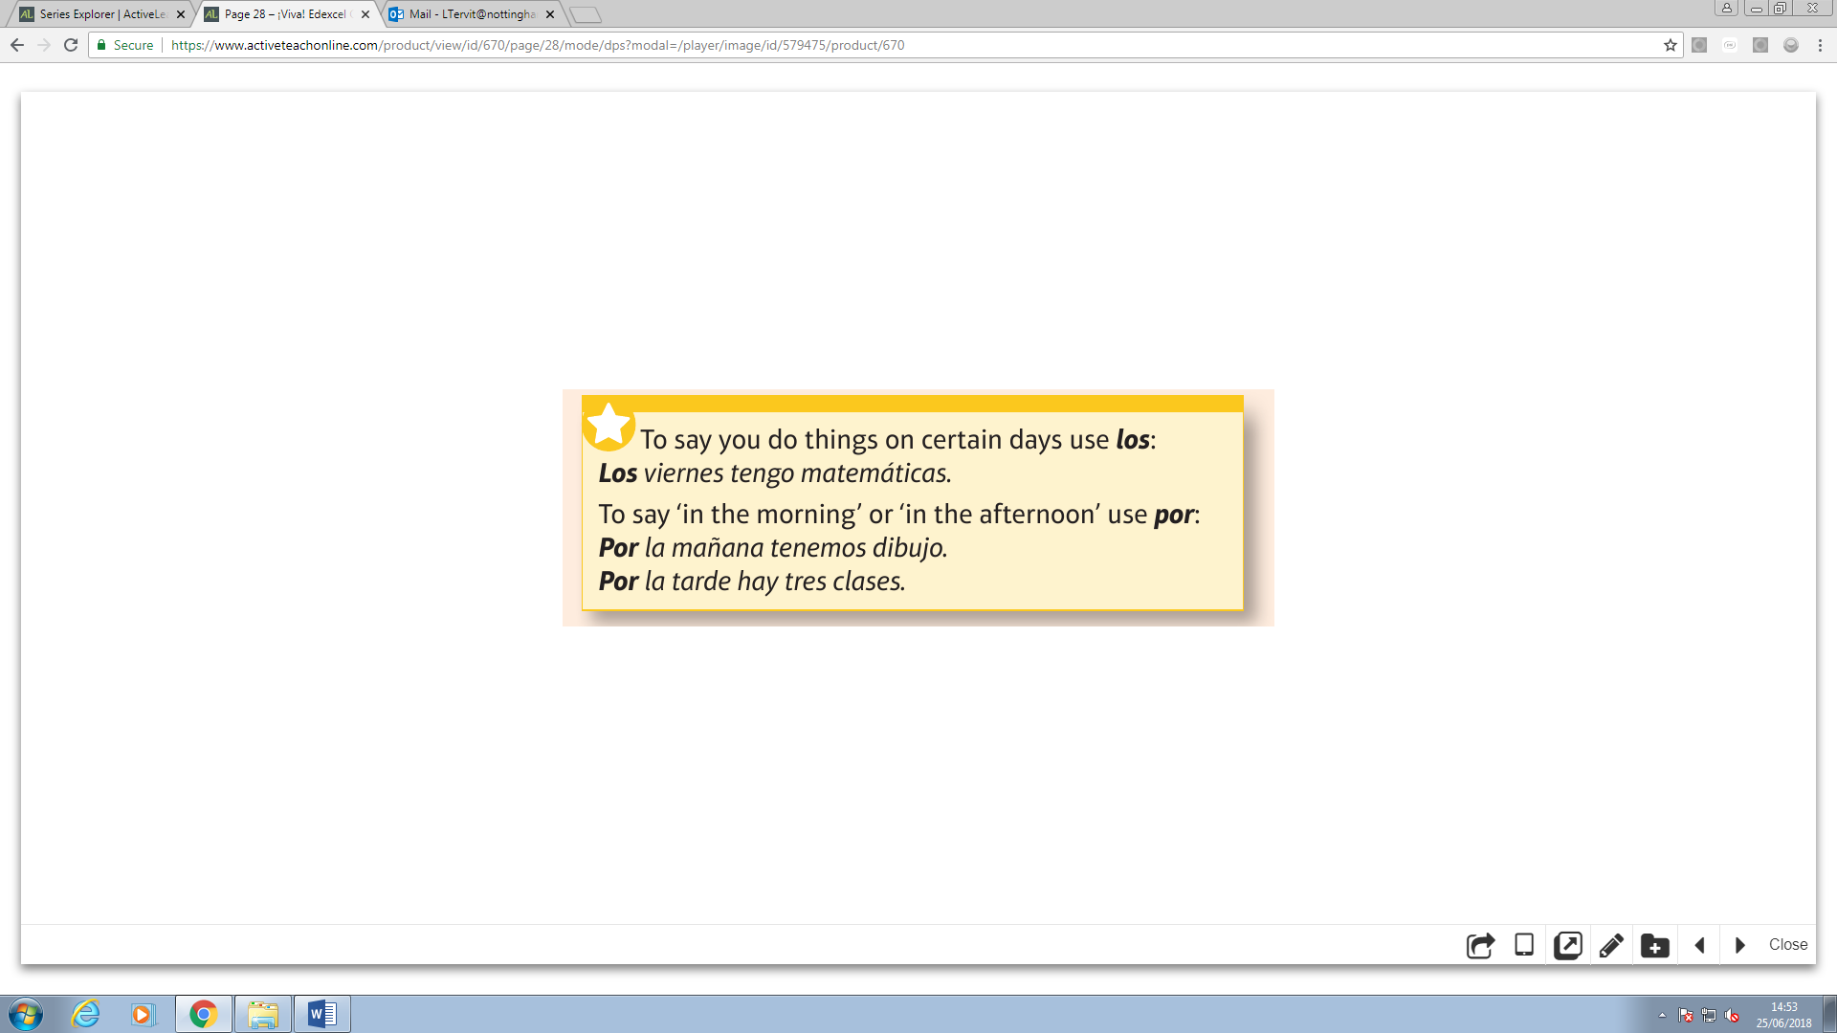
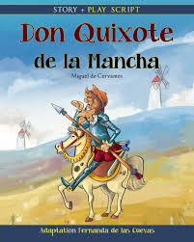
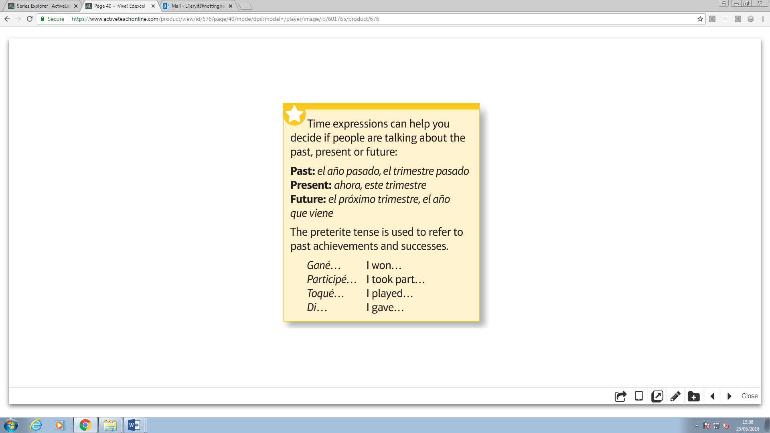
Year 9 Homework
Knowledge Organiser
Autumn Term 2
Spanish
Negatives & superlatives - https://quizlet.com/_5hvx7i
Don Quixote de la Mancha written by Miguel de Cervantes.
Published in two parts, in 1605 and 1615, Don Quixote is the most influential work of literature from the Spanish Golden Age and the entire Spanish literary canon. It is translated in 145 languages and is the most translated book after the Bible.

Slide 3
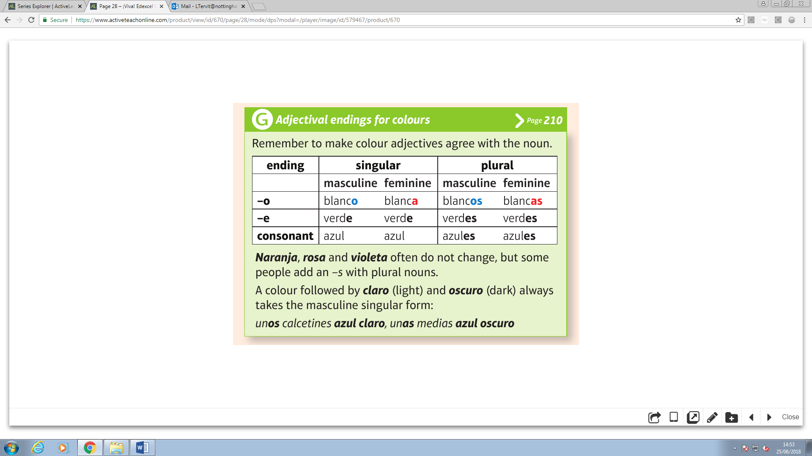
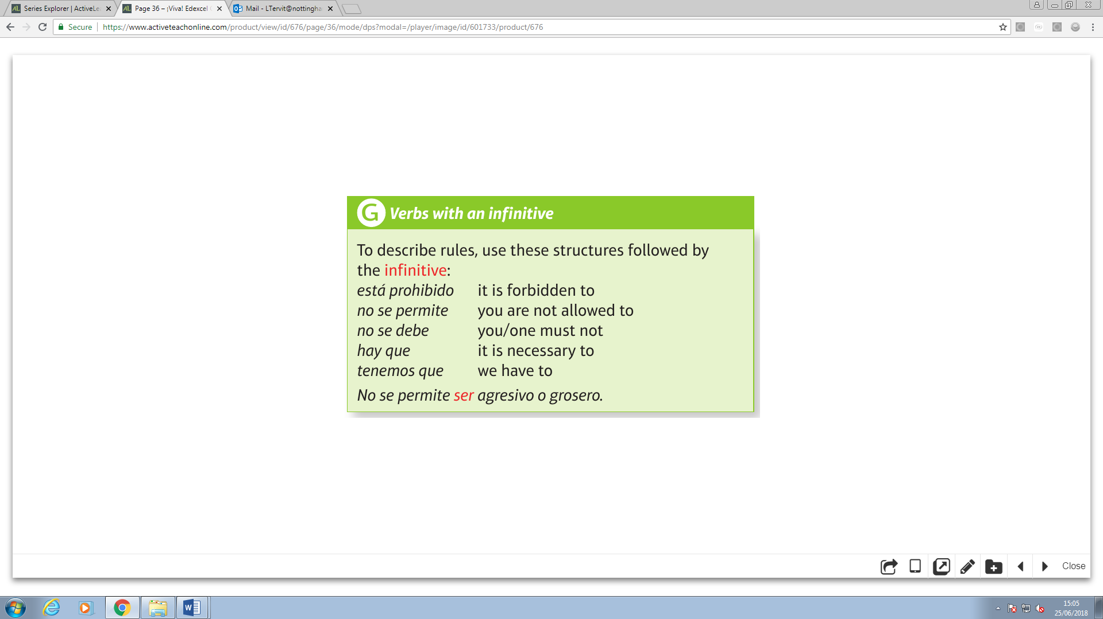
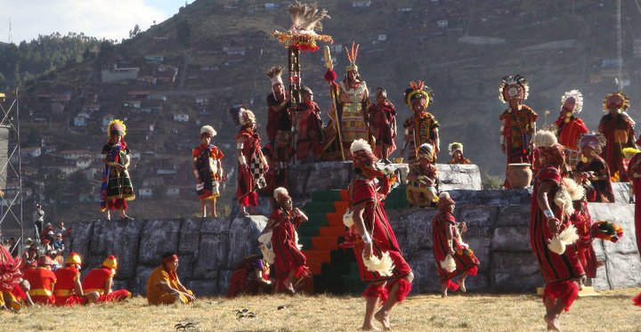
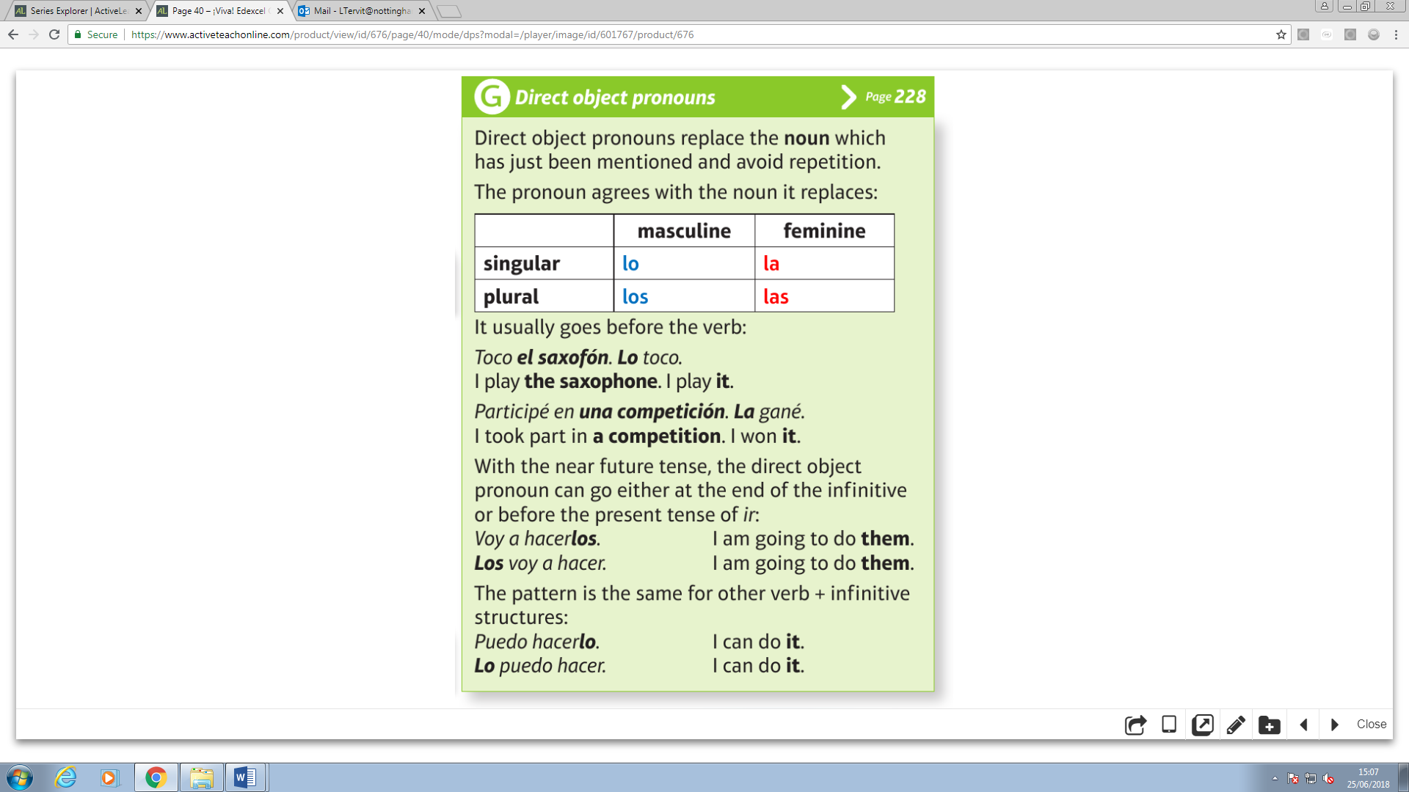
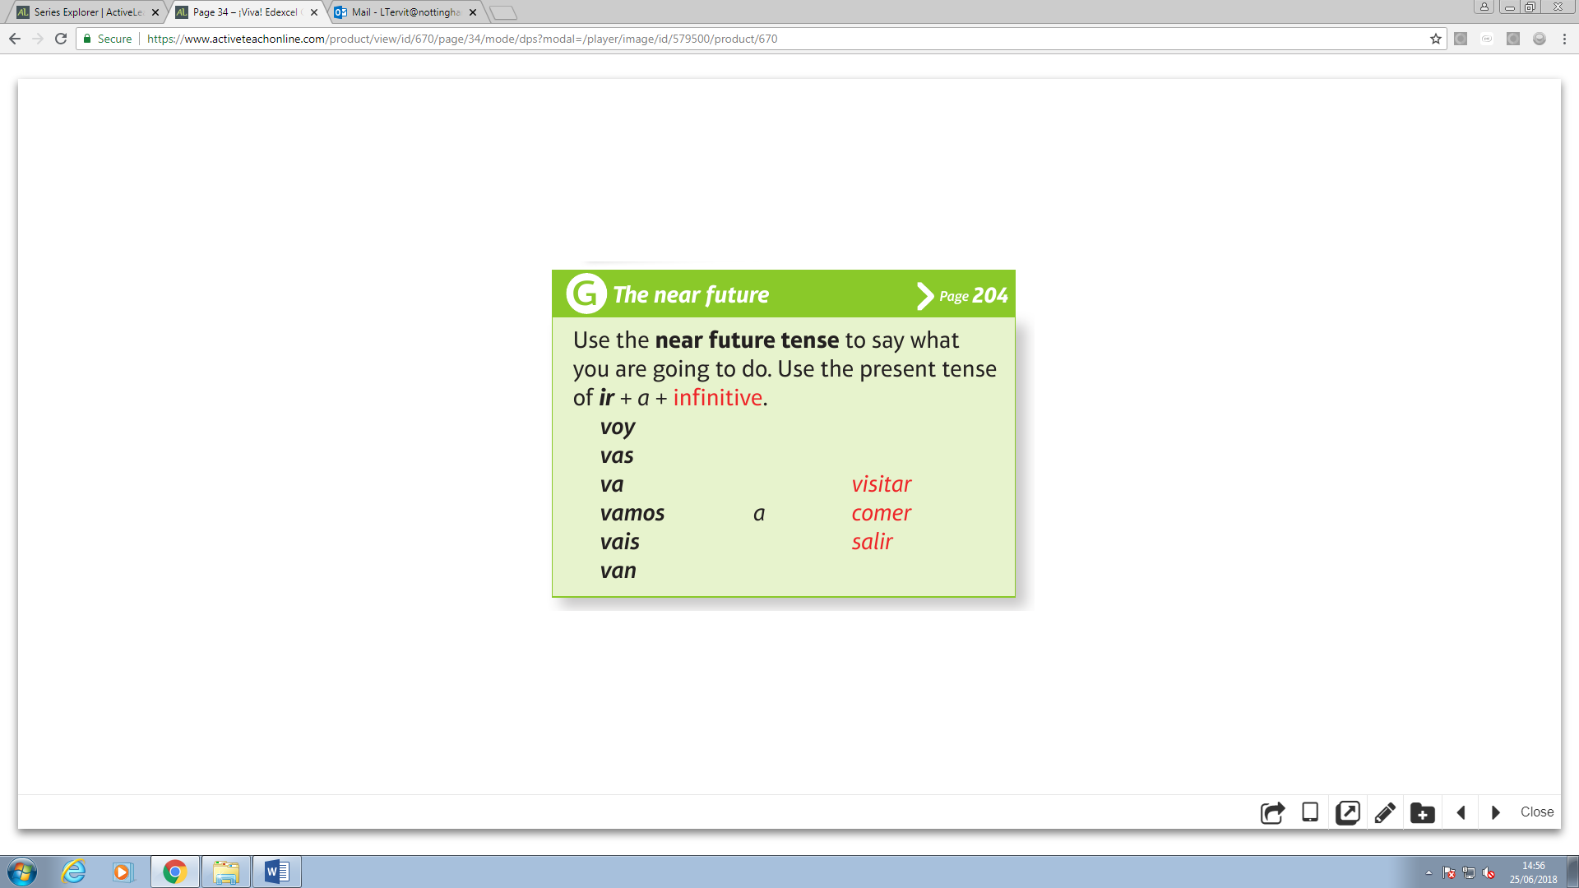
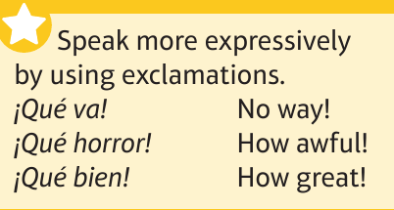
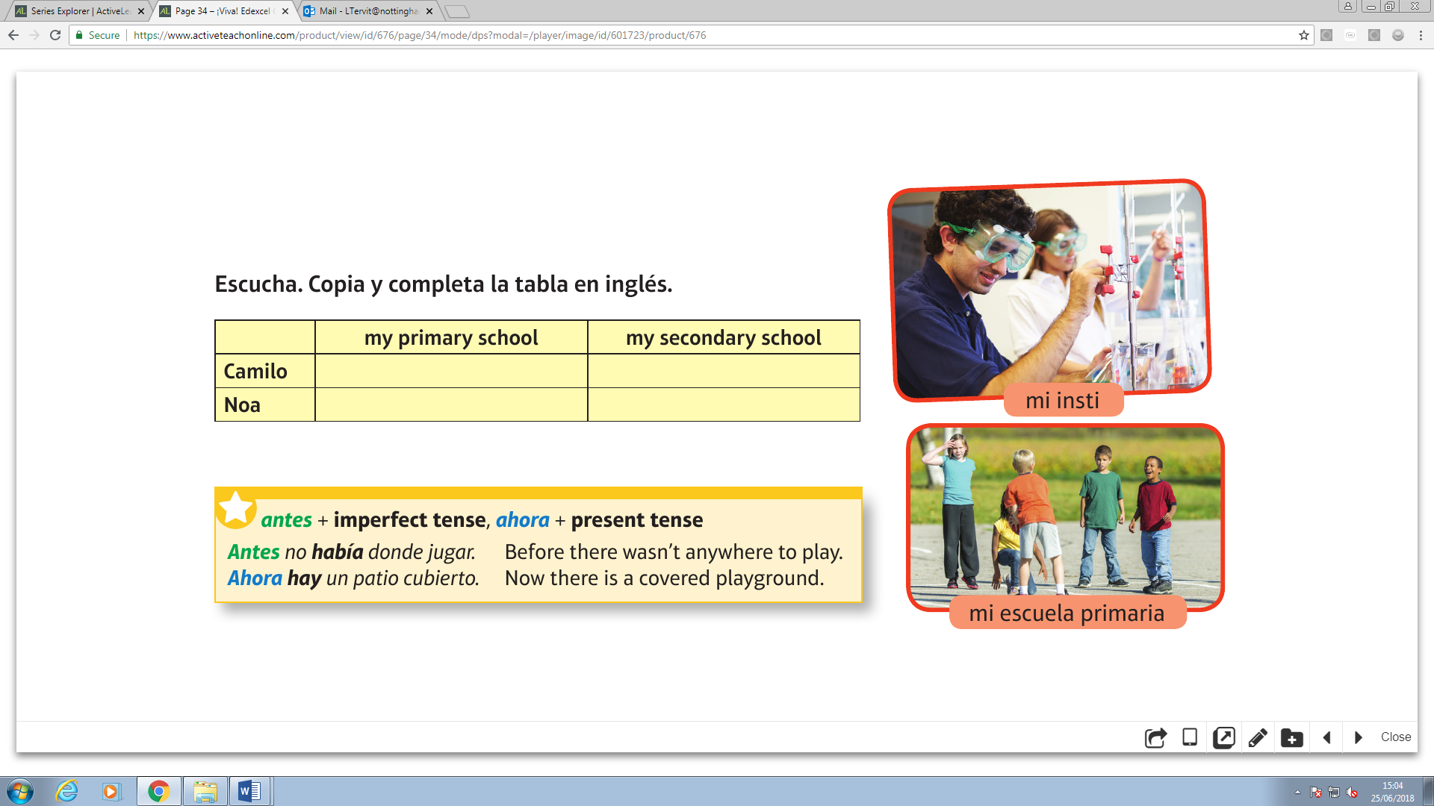

Year 9 Homework
Knowledge Organiser
Spring Term 1
Spanish
Object pronouns & infinitives - https://quizlet.com/_5hvx7i
The Incas, an American Indian people, were originally a small tribe in the southern highlands of Peru. In less than a century, during the 1400s, they built one of the largest, most tightly controlled empires the world has ever known
On the 24th June every year, Cusco in Peru celebrates the most famous of all pre-Columbian festivals: the Inti Raymi, also known as the Inca Festival of the Sun. Inti was one of the most revered gods for the ancient Incas and his festival, which first started in the early 1400s, is aimed to honour him.

Slide 4
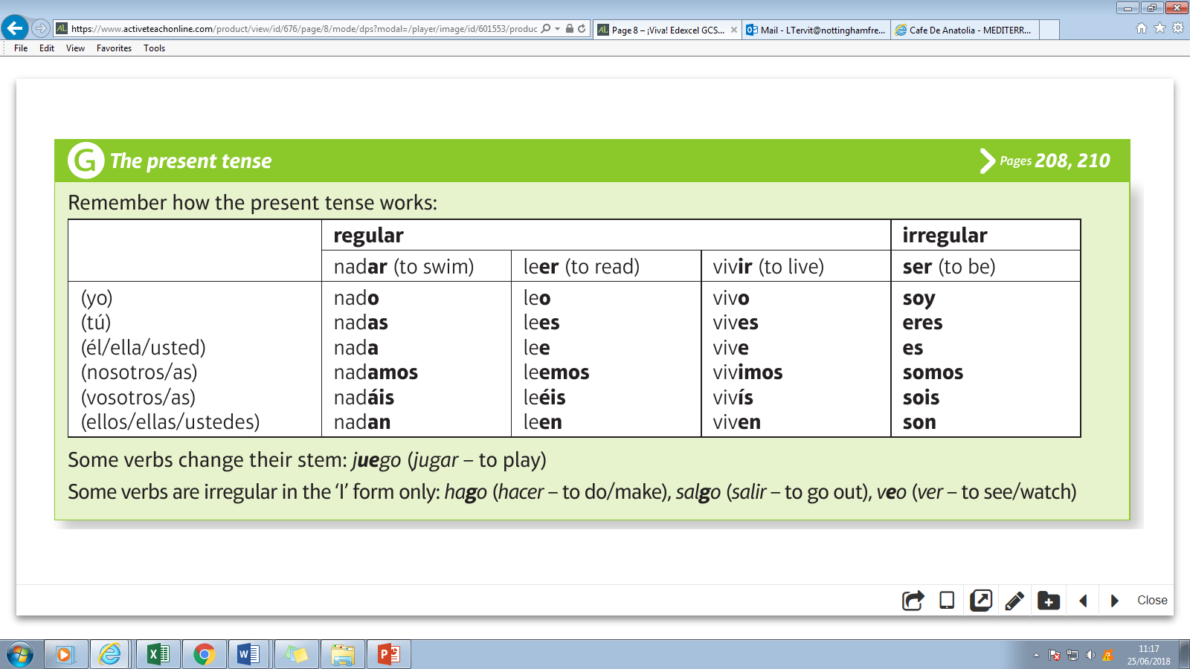
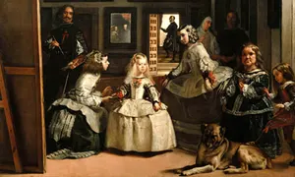
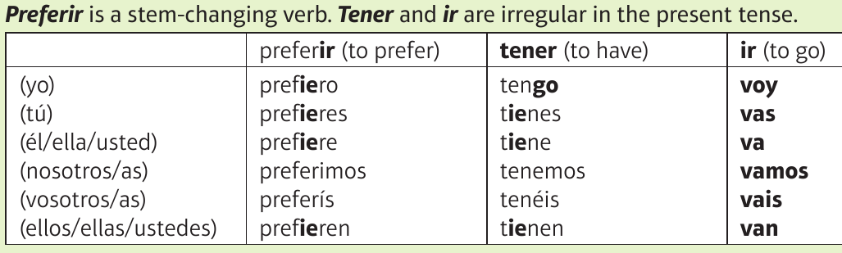
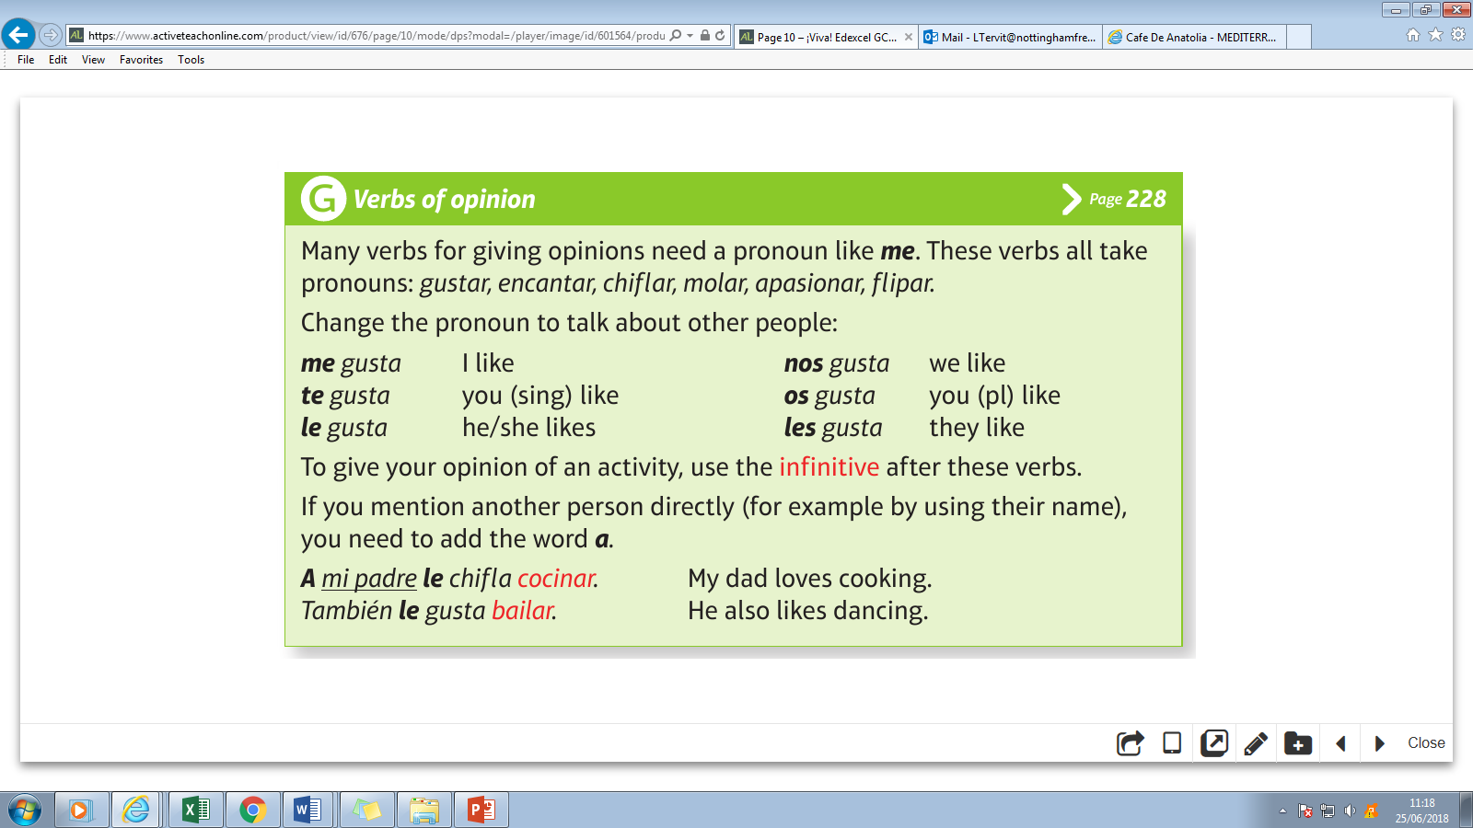
Year 9 Homework
Knowledge Organiser
Spring Term 2
Spanish
Present & stem changing verbs - https://quizlet.com/_5n6bfl
One of the masters of Baroque painting, Diego Velazquez is one of the most famous portrait artists in history. Velazquez, born in Seville, was a lead painter in King Philip IV’s court, and only produced an estimated 120 canvases in his lifetime. His most well known painting is Las Meninas (below)
I swim
Do you swim?
He/she/it swims
We swim
Do you(pl) swim?
They swim
I am
Are you?
He/she/it is
We are
You (pl) are
They are
I have
Do you have?
He/she/it has
We have
You (pl) have
They have

Slide 5
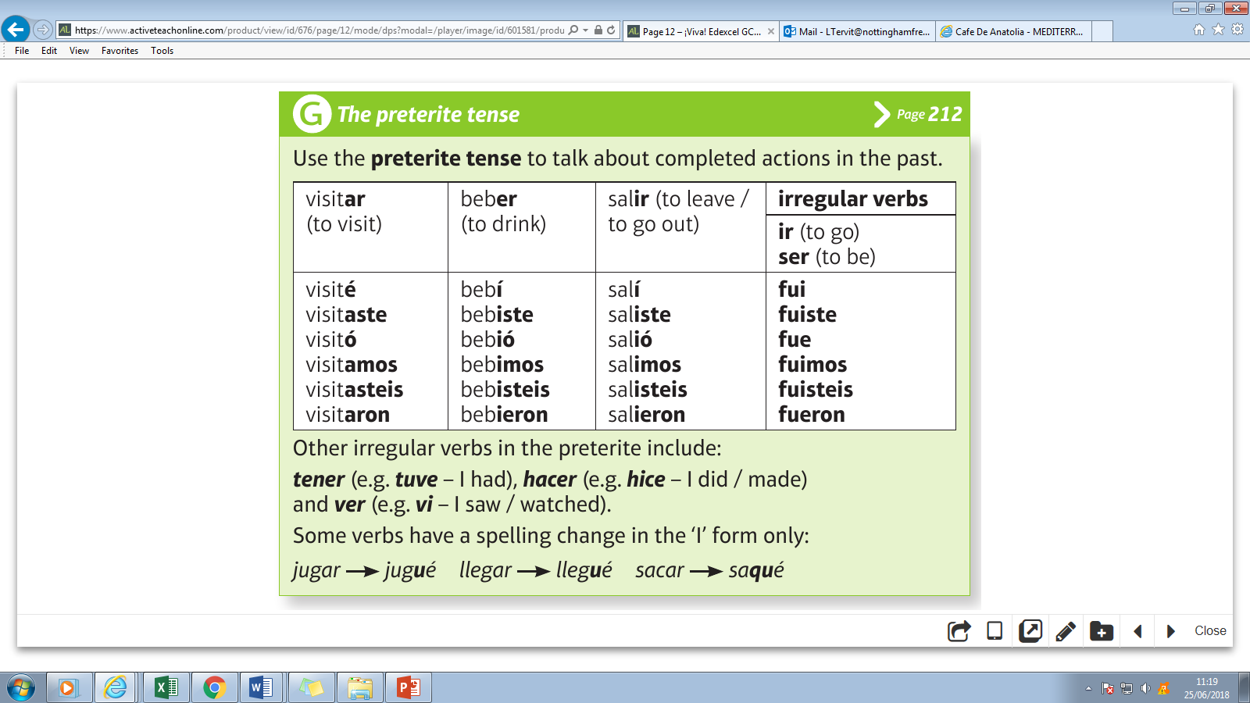
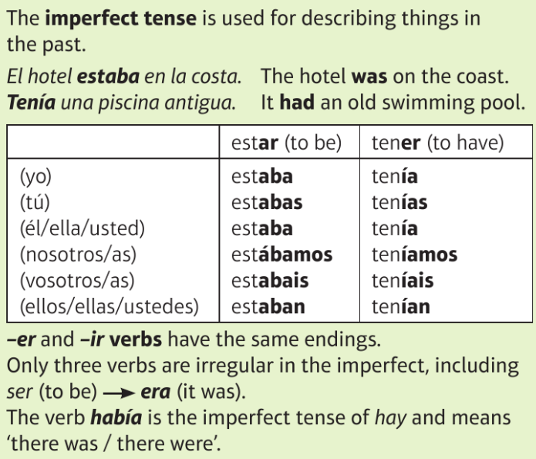
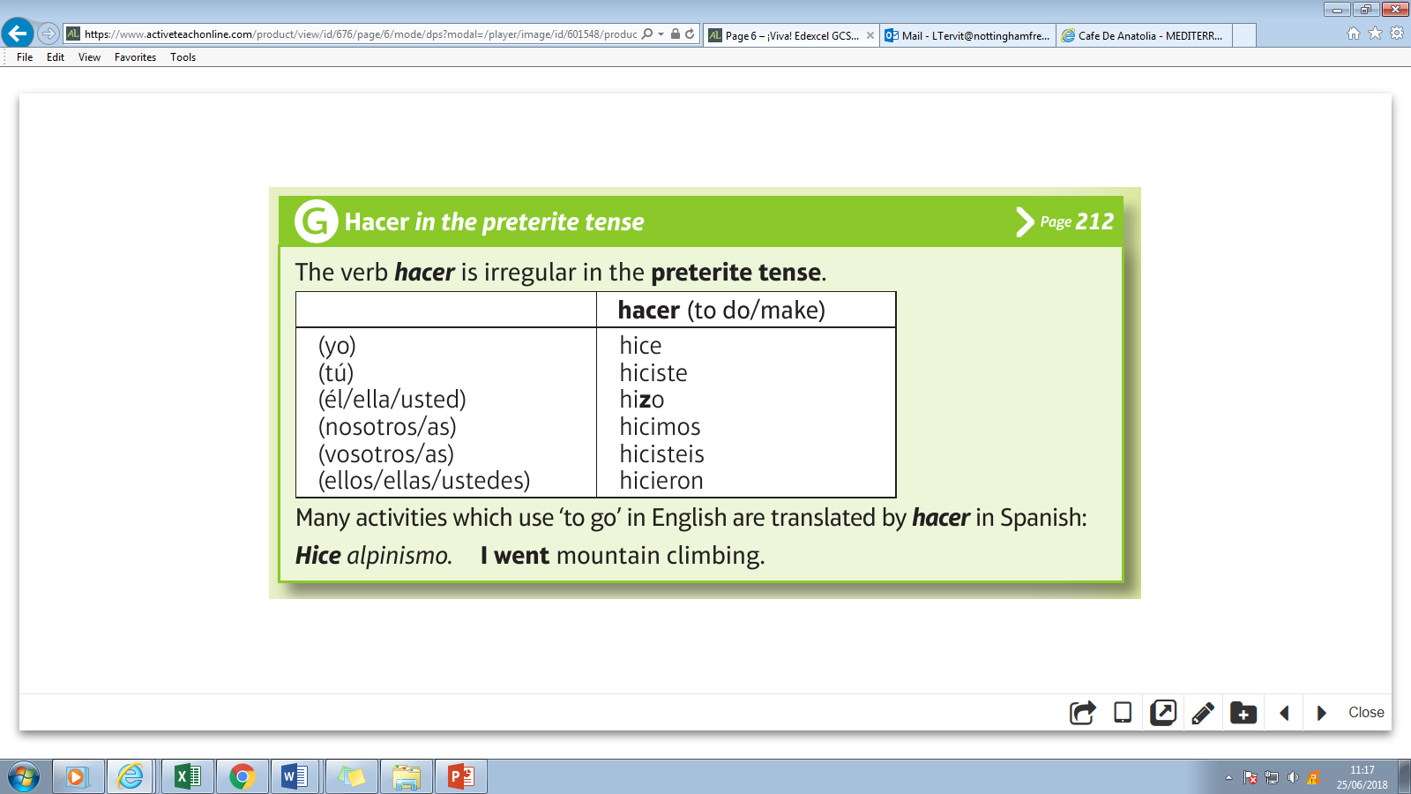
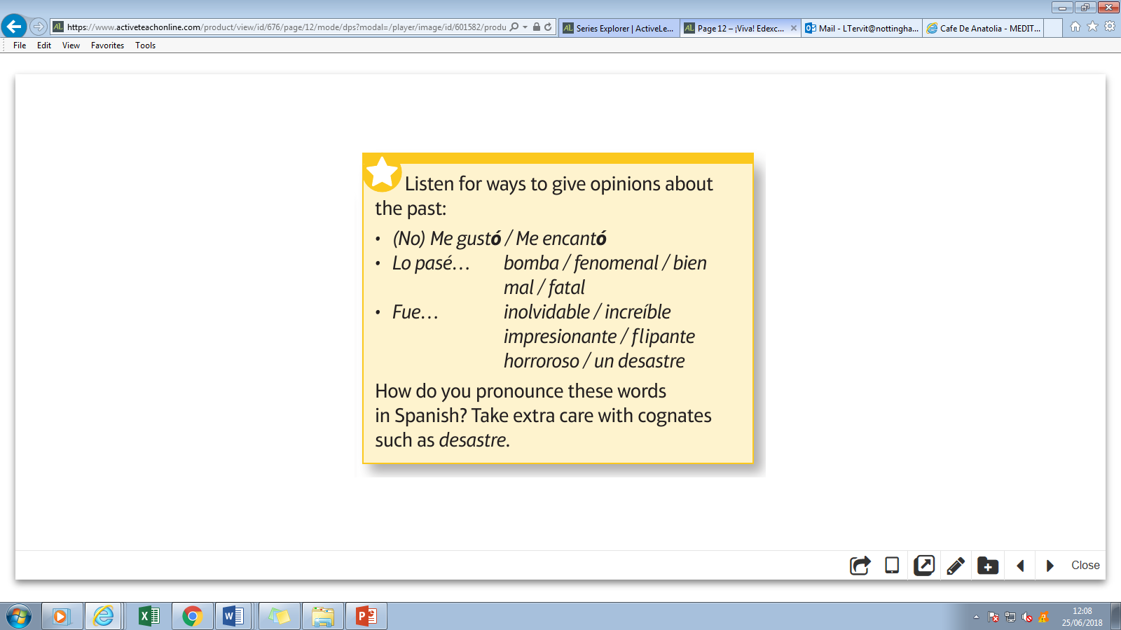
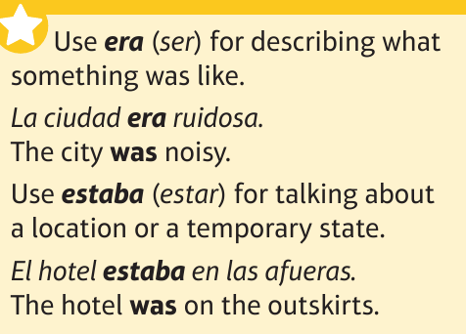
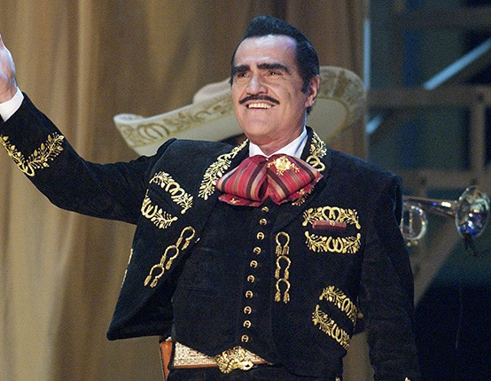
Year 9 Homework
Knowledge Organiser
Summer Term 1
Spanish
Preterite & imperfect verbs - https://quizlet.com/_5n6bfl
I went
Did you go?
He/she/it went/was
We went
Did you(pl) go?
They went/were
I had / used to have
Did you used to have?
He/she/it had / used to have
We had / used to have
Did you(pl) have / used to have?
They had / used to have
I did
Did you?
He/she/it did
We did
Did you(pl)?
They did
The king of ranchera music, Vicente Fernandez perfectly embodies the grandeur of the charro -- a regally costumed, cowboy-like male figure in traditional Mexican music

Slide 6
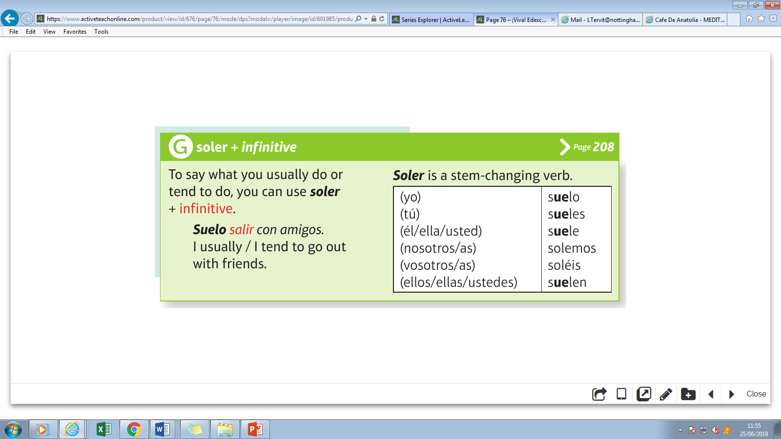
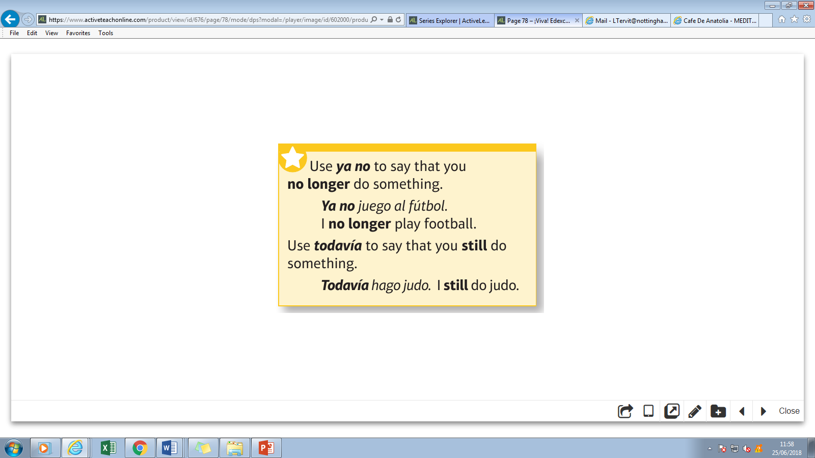
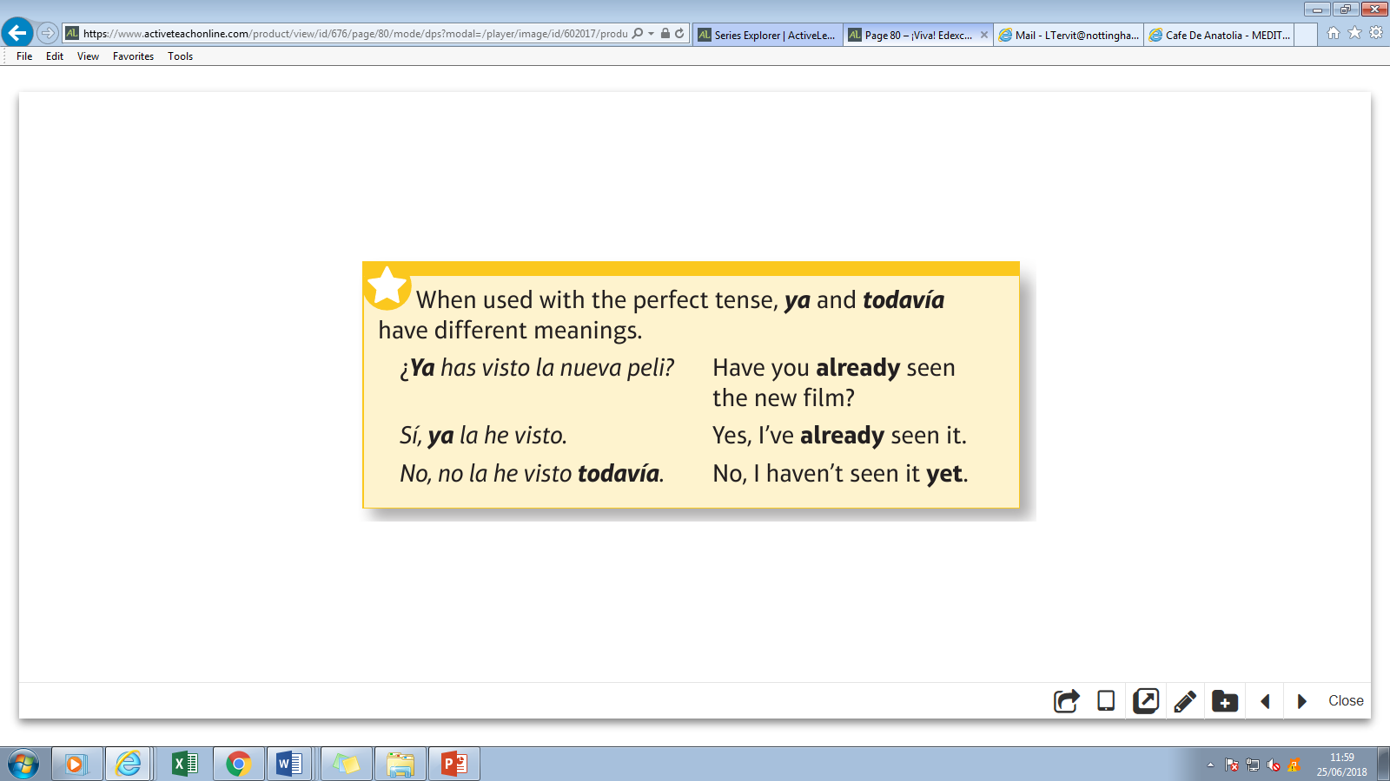
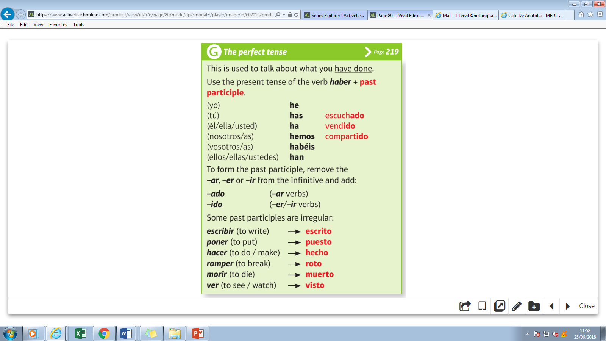
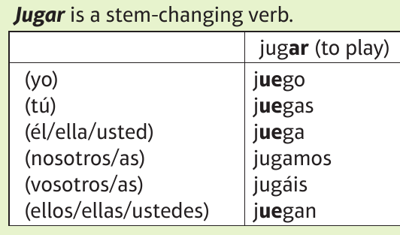
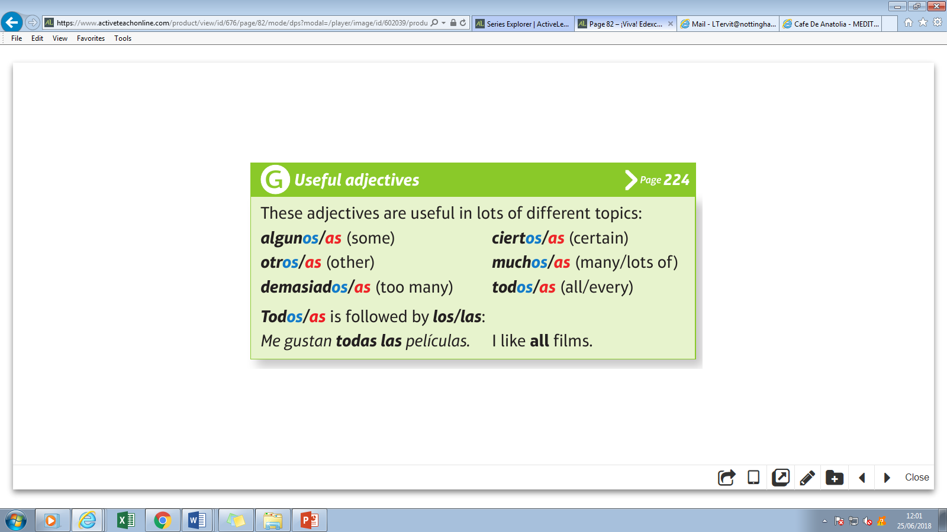
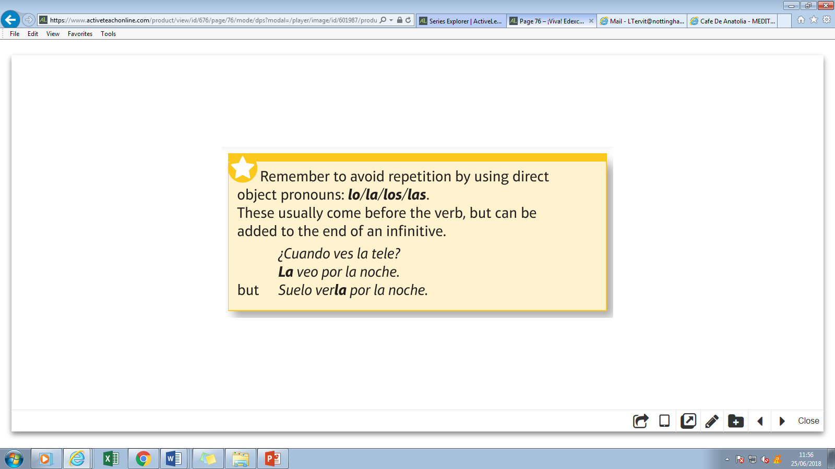
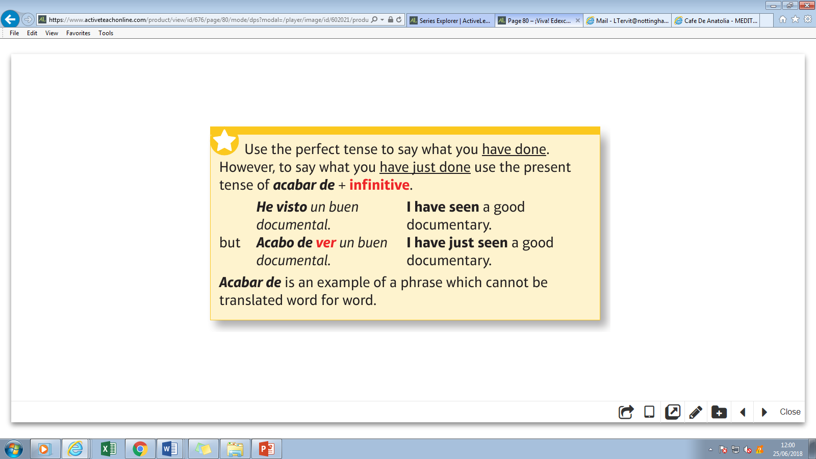
Year 9 Homework
Knowledge Organiser
Summer Term 2
Spanish
Perfect tense - https://quizlet.com/_5kxgvb
I play
Do you play?
He/she/it plays
We play
Do you(pl) play?
They play
written
put
done/made
broken
died
seen
= when do you watch TV?
= I watch it at night
= I usually watch it at night

