Slide 1
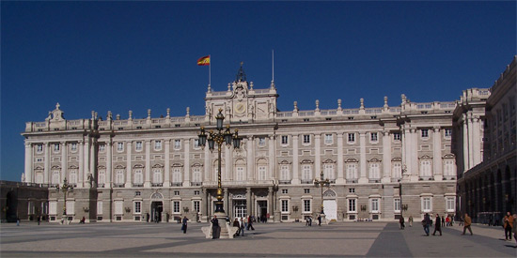
Year 8 Homework
Knowledge Organiser
Autumn Term 1
Spanish
Present Continuous KO 1 -3 chilli: quizlet.com/_8bq66u 2 chilli: quizlet.com/_8bqa2z 1 chilli: quizlet.com/_8bqbpu
To say you usually do something, use soler + a verb in the infinitive, eg I usually read
There are two ways of saying “get on well/badly with”:
1.llevarse bien/mal
me llevo bien/mal con – I
te llevas bien con – you
se lleva bien con – s/he
nos llevamos bien con – we
os llevais bien con – you plural
se llevan bien con – they
eg me llevo bien con mi madre = I get on well with my Mum
2.caer bien/mal (works like gustar)
Me cae(n) bien/mal - I
Te cae(n) – you
Le cae(n) – s/he
Nos cae(n) - we
Os cae(n) – you plural
Les cae(n) - they
Me caen bien mis primos – I get on well with my cousins
Le cae mal su tío – she gets on badly with her uncle
SOLER – to usually…
suelo – I usually
sueles – you usually
suele – s/he usually
solemos – we usually
soléis – you (plural) usually
suelen – they usually
Infinitives
ir en coche – to go by car
visitar a los amigos – to visit friends
ver la tele – to watch TV
hacer deporte – to do sport
comer a la una en punto – to eat at one on the dot
Examples:
Suelo ir al instituto en coche / levantarme a las siete– I usually go to school by car/ get up at 7
Suele comer en la cantina – he/ she usually eat in the canteen
Solemos ver la tele por la tarde – we usually watch TV in the evening
Suelen visitar a sus abuelos los domingos =they usually visit their grandparents on Sundays
+
El Palacio Real de Madrid (Royal Palace in Madrid)
Soler is a radical or stem-changing verb – look at the o→ue
To say what you are doing or to describe what is happening,
use the present continuous, eg I am listening
1) Write the correct part of estar
2) Take the AR, ER or IR from the end of the infinitive to make the gerund (or the –ing)
ESTAR – to
estoy – I am
estás– you are
está – s/he is
estamos – we are
estáis – you (plural) are
están– they are
Irregular gerunds
Leyendo= reading
durmiendo - sleeping
+ ando (AR verbs)
+ iendo (IR/ER verbs)
Use SER to describe character (permanent) Soy inteligente. = I am intelligent
Masculine
Unos helados (some ice-creams)

Slide 2
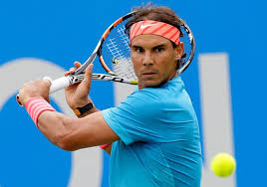
Year 8 Homework
Knowledge Organiser
Autumn Term 1
Spanish
Present Continuous KO 1 -3 chilli: quizlet.com/_8bq66u 2 chilli: quizlet.com/_8bqa2z 1 chilli: quizlet.com/_8bqbpu
To say have to:
TENER QUE
tengo que – I have to
tienes que – you have to
tiene que – s/he has to
tenemos que – we have to
tenéis que – you pl have to
tienen que – they have to
To say must:
DEBER
debo – I must
debes – you must
debe – s/he must
debemos – we must
debéis – you (pl) must
deben – they must
IMMEDIATE FUTURE To say what you are going to do use IR + infinitive
Radical changing verbs
These are verbs that have a spelling change in the middle. Soler is one of them (see above). Here are a few more:
merendar – to have a snack
meriendo – I snack
meriendas – you snack
merienda – s/he snack
merendamos – we snack
merendais – you (plural snack
meriendan – they snack
almorzar – to have lunch / to have…for lunch
almuerzo – I have lunch
almuerzas – you have
almuerza – s/he polite has lunch
almorzamos – we have lunch
almorzáis – you (pl) have lunch
almuerzan – they have lunch
IR – to go
voy a – I go / am going to
vas a - you go / are going to
va a – s/he goes/ is going to
vamos a – we go / are going to
vais a – you (pl) go / are going to
van a – they go / are going to
Then add an infinitive, eg
Tengo que fregar los platos – I have to wash the dishes
Debemos hacer las camas – we must make the bed
Hay que pasar la aspiradora – it is necessary to vaccum clean
Mi hermana tiene que recoger su dormitorio – my sister has to tidy up her room
Infinitives
visitar a mis abuelos –visit my grandparents
pasear al perro - walk the dog
hacer los deberes – do homework
hay que – it is necessary to
The personal a has no real translation in English.
You use it with certain verbs (visitar, ayudar) when talking about something you are doing with people.
Voy a visitar a mis abuelos = I am going to visit my grandparents (people)
Voy a visitar el mueso = I am going to visit the museum (thing)
Examples
Voy a lavarme el pelo – I’m going to wash my hair
¿vas a ayudar en el jardín?
Are you going to help in the garden?
Rafael Nadal, tenista famoso español

Slide 3
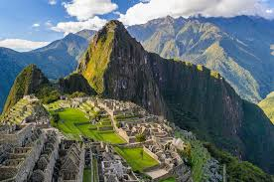
Year 8 Homework
Knowledge Organiser
Autumn Term 2
Spanish
Imperfect tense KO 2: https://quizlet.com/_5hw5x9
Machu Picchu, Peru
Believed to be the royal estate or sacred religious site of the Inca leaders who were wiped out by Spanish invaders in the 16th century (1532-1572)
Masculine
Unos helados (some ice-creams)

Slide 4
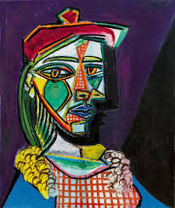
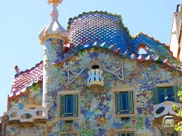
Year 8 Homework
Knowledge Organiser
Autumn Term 2
Spanish
Imperfect tense KO 2: https://quizlet.com/_5hw5x9
Large numbers - The spelling of large numbers changes.
100 – ciento (on its own + before another number) cien (before nouns) eg, cien euros – 100€ ciento veinte euros – 120€
These all agree with the nouns that follows. eg, doscientas manzanas
200 – doscientos/doscientas 500 – quinientos /quinientas 800 – ochocientos/ochocientas
300 – trescientos/trescientas 600 – seiscientos/seiscientas 900 – novecientos/novecientas
400 – cuatrocientos/cuatrocientas 700 – setecientos/setecientas
Demonstrative pronouns | this | that (close) | that (far)
masc sing | este | ese | aquel
fem sing | estas | esa | aquella
 | these | those | those
masc pl | estos | esos | aquellos
fem p | estas | esas | aquellas
Una obra de arte (artwork) de Pablo Picasso, pintor español
La arquitectura de Gaudí
Antoni Gaudí architecture in Barcelona
Masculine
Unos helados (some ice-creams)

Slide 5
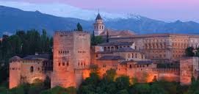
Year 8 Homework
Knowledge Organiser
Spring Term 1
Spanish
Past preterite tense KO 3: https://quizlet.com/_5lj05v
Adverbs - Use adverbs to describe actions, eg quickly, softly
The majority of English adverbs end in -ly.
In Spanish, they end in –mente.
rápidamente – quickly desafortunadamente – unfortunately apresuradamente - hastily
La Alhambra - palacio en Granada

Slide 6
Year 8 Homework
Knowledge Organiser
Spring Term 1
Spanish
Past preterite tense KO 3: https://quizlet.com/_5lj05v
TO THE =
a + el = al (masc)
a la (fem)
a los (masc pl)
a las (fem pl)
Voy al mercado = I go to the market
Hernán Cortés – Spanish conquistador who caused the fall of the Aztec Empire in Mexico (1519-1521)
que = that
El mueso que está en el centro = the museum that is in the centre
Lo que = what
Lo que más me gusta es = what I like most is

Slide 7
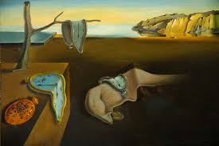
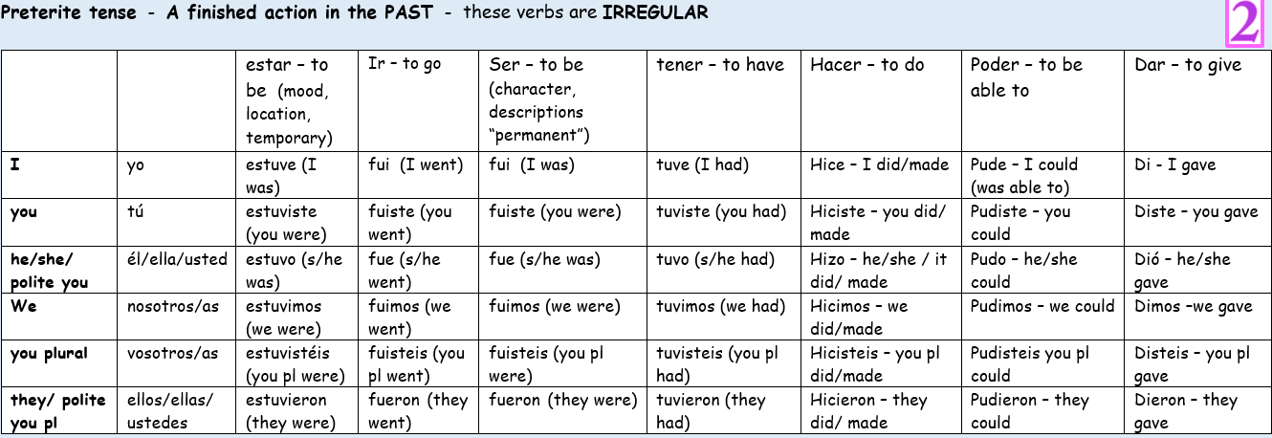
Year 8 Homework
Knowledge Organiser
Spring Term 2
Spanish
Reflexive & preterite tense verbs KO 4: https://quizlet.com/_5xv0wm
Obras de arte de Salvador Dalí – artista surrealista español
Masculine
Unos helados (some ice-creams)

Slide 8
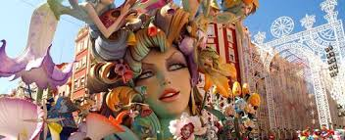
Year 8 Homework
Knowledge Organiser
Spring Term 2
Spanish
Reflexive & preterite tense verbs KO 4: https://quizlet.com/_5xv0wm
Hoy voy a jugar al fútbol = Today, I am going to play football
En el futuro, jugaré en un buen equipo = in the future, I will play in a good team
Las Fallas, Valencia
next to
between
in front of
in, on /within
behind
under
opposite
on top of
Masculine
Unos helados (some ice-creams)

Slide 9
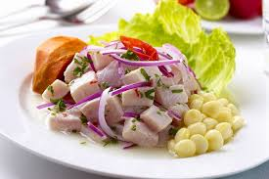
Year 8 Homework
Knowledge Organiser
Summer Term 1
Spanish
Comparatives KO 5: https://quizlet.com/_68ehao
You can make a sentence negative by putting ‘no’ or other negatives in front of the verb.
Nada = nothing
Nadie = no-one
Nunca = never
Ni…ni = neither…nor
Tampoco = not either /neither
Ningún = none / not a single one
No me gusta el deporte = I don’t like sport
No voy nunca a la piscina = I never go to the pool
La semana pasada, no compré nada en el supermercado = last week, I bought nothing at the supermarket
No me gustan ni el inglés ni las ciencias =
I neither like English nor science
Más…que = more… than
Menos…que = less… than
El/la más = the most
El/la menos = the least
Tan…como = as…as
Chile no es tan grande como Argentina =
Chile is not as big as Argentina
Tanto/tanta/tantos/tantas = so much / so many
Chile exporta tantos productos como Argentina =
Chile exports as many products as Argentina
Lo difícil de aprender idiomas es la gramática =
The difficult thing about learning languages is the grammar
Lo mejor de Latinoamérica es su diversidad =
The best thing about Latin America is its diversity
Lo bueno del Caribe es su clima =
the best thing about the Caribbean is its climate
El ceviche – un plato típico de Perú. Es fresco y a base de maricos
Permitir = to allow
Mi madre me permite =
My Mum allows/lets me
Mis padres no me permiten =
My parents don’t allow me
Puedo = I can No puedo = I can not
Su madre le permite = her Mum allows her
Sus padres no les permiten = their parents don’t allow them
John puede salir cuando quiere = John can go out when he wants
Pero no puede tener piercings = but he can’t have piercings
Remember when you give your age in Spanish, you use the verb TENER (to have), not SER (to be)
Here are some other idiomatic uses of TENER:
To be 18 = tener dieciocho años
To be successful = tener éxito
To be hungry / thirsty = tener hambre / tener sed
To be cold / hot = tener frío / calor
To be right = tener razón
To be lucky = tener suerte
To be scared = tener miedo
Impersonal se:
When the subject of a verb is not specified (but human), the ‘he/she’ 3rd person ending is used:
En Latinoamérica, se come bien = in Latin America, one eats well / they eat well

Slide 10
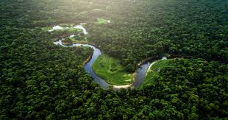
Year 8 Homework
Knowledge Organiser
Summer Term 2
Spanish
Future tense KO 6: https://quizlet.com/_6rvhiw
Se puede = you can
Se debe = we must
Hay que = we have to
Se puede reciclar = you can recycle
Tener que = to have to
Tengo que = I have to
Tengo que apagar la luz = I have to turn off the lights
Tienes que ahorrar agua = you have to save water
Suelo ir = I usually go
Solía ir al cine = I used to go to the cinema
La selva amazónica – es el bosque tropical más grande del mundo y se encuentra en 9 países sudamericanos pero está en peligro de la deforestación
Iré a Londres = I will go to London
Estudiaré en la universidad = I will study at university
VOLVER – TO RETURN
Volveré = I will return
Volverás = you will return
Volverá = he/she/it will return
Volveremos = we will return
Volveréis = you (pl) will return
Volverán = they will return

