Slide 1





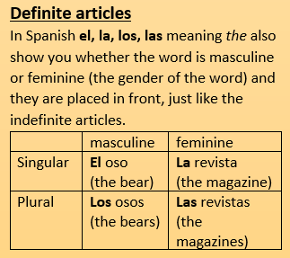



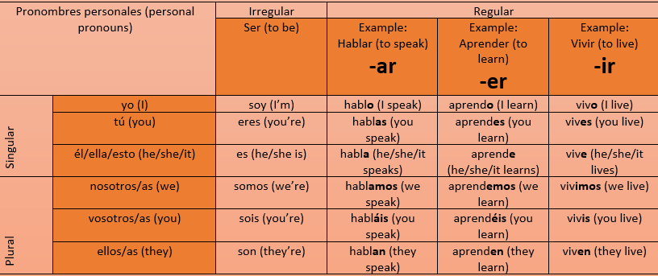



Year 7 Homework
Knowledge Organiser
Autumn Term 1
Spanish
Present tense: https://quizlet.com/_5hw1zi
Four ways to say ‘you’
When you are giving instructions to:
One person as a friend use tú
Several people you know use vosotros.
One person politely use usted
several people politely use ustedes
Indefinite articles
Un perro (a dog) MASCULINE
Una familia (a family) FEMININE
Unos jóvenes (some young people) MASCULINE PLURAL
Unas revistas (some magazines) FEM FEMININE PLURAL
llamarse (to be called)
tener (to have)
me llamo (I’m called)
tengo (I have)
te llamas (you’re called)
tienes (you have)
se llama (he/she/ it is called)
tiene (he/she/ it has)
se llaman (they are called)
tienen (they have)
Masculine
Unos helados (some ice-creams)

Slide 2
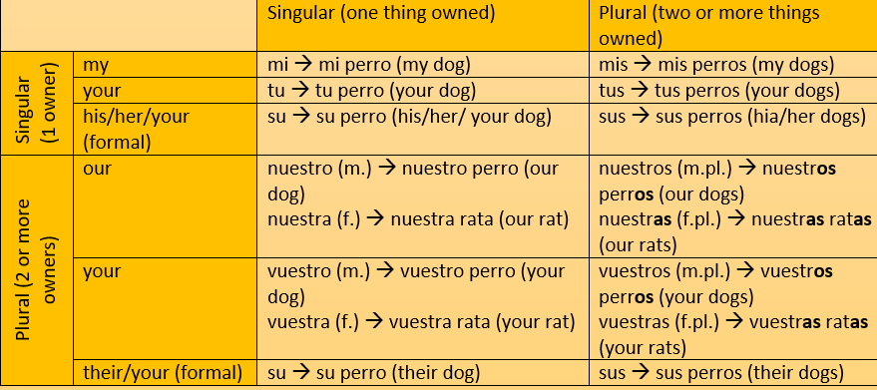
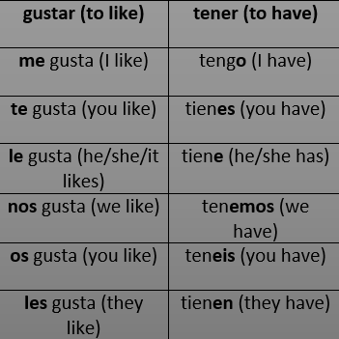
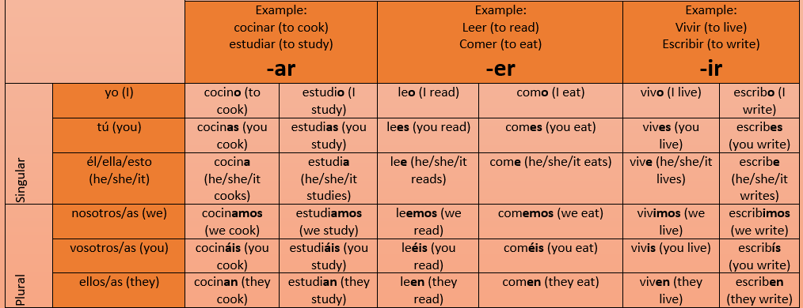
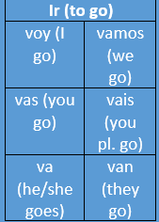

Year 7 Homework
Knowledge Organiser
Autumn Term 2
Spanish
Possessive adjectives: https://quizlet.com/_5kn04e
un poco (a bit) muy (very) bastante (quite) demasiado (too) también (also) sin embargo (however) pero (but)
Hay = there is
No hay = there is not

Slide 3
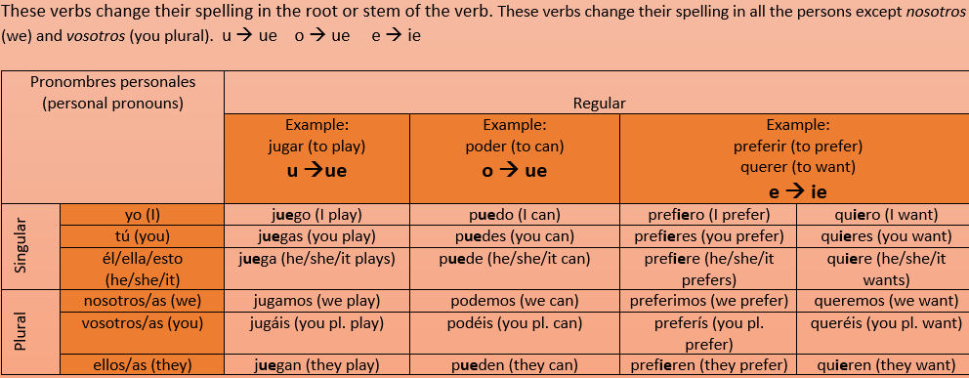
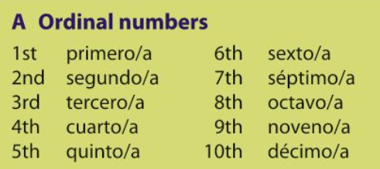
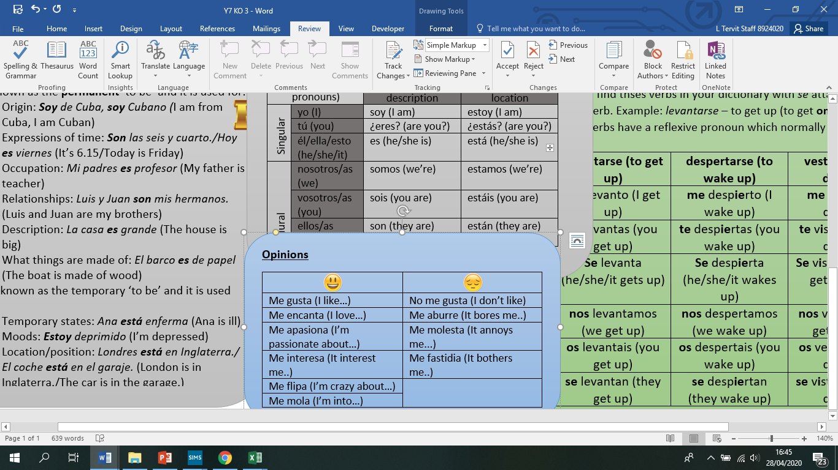
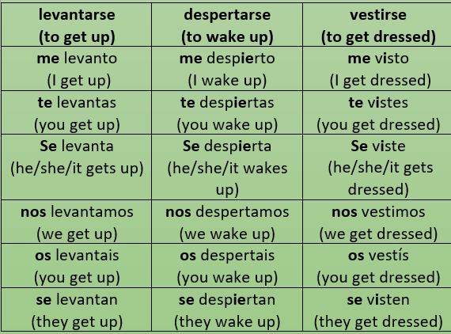
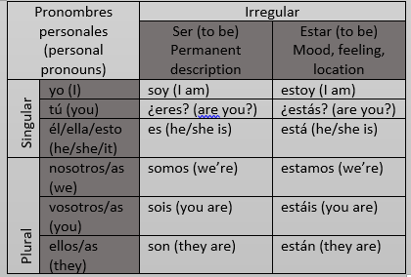
Year 7 Homework
Knowledge Organiser
Spring Term 1
Spanish
Stem-changing verbs: https://quizlet.com/_5lisvs
Voy al instituto (masculine)
= I go to school
Voy a la piscina (feminine)
= I go to the pool

Slide 4
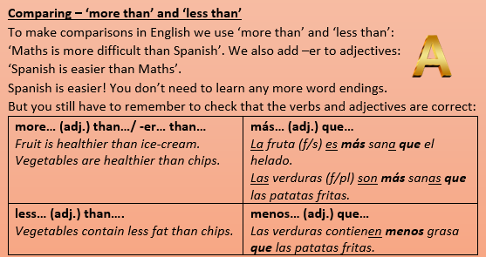
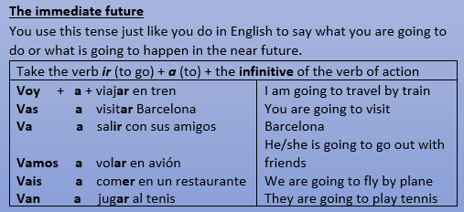


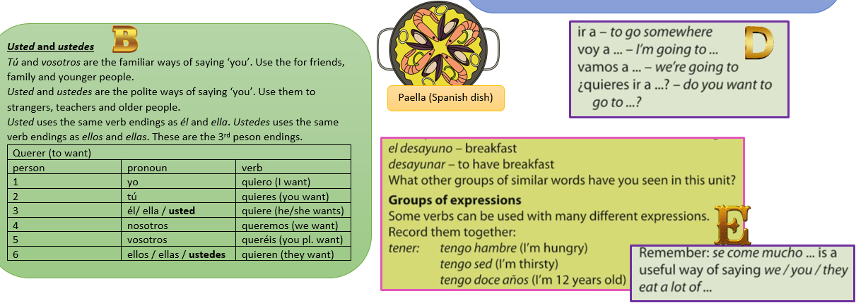
Year 7 Homework
Knowledge Organiser
Spring Term 2
Spanish
Near future tense: https://quizlet.com/_5xv2vj
Maracas (Mexican musical instrument)

Slide 5
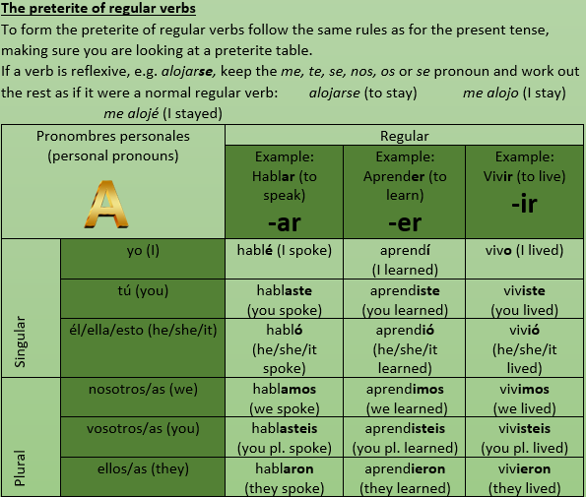
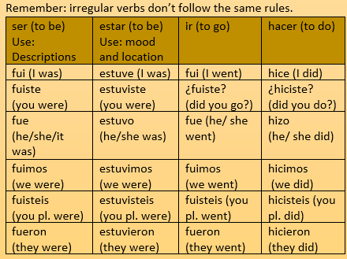
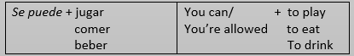

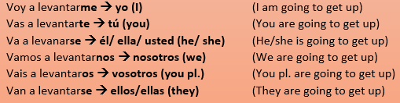
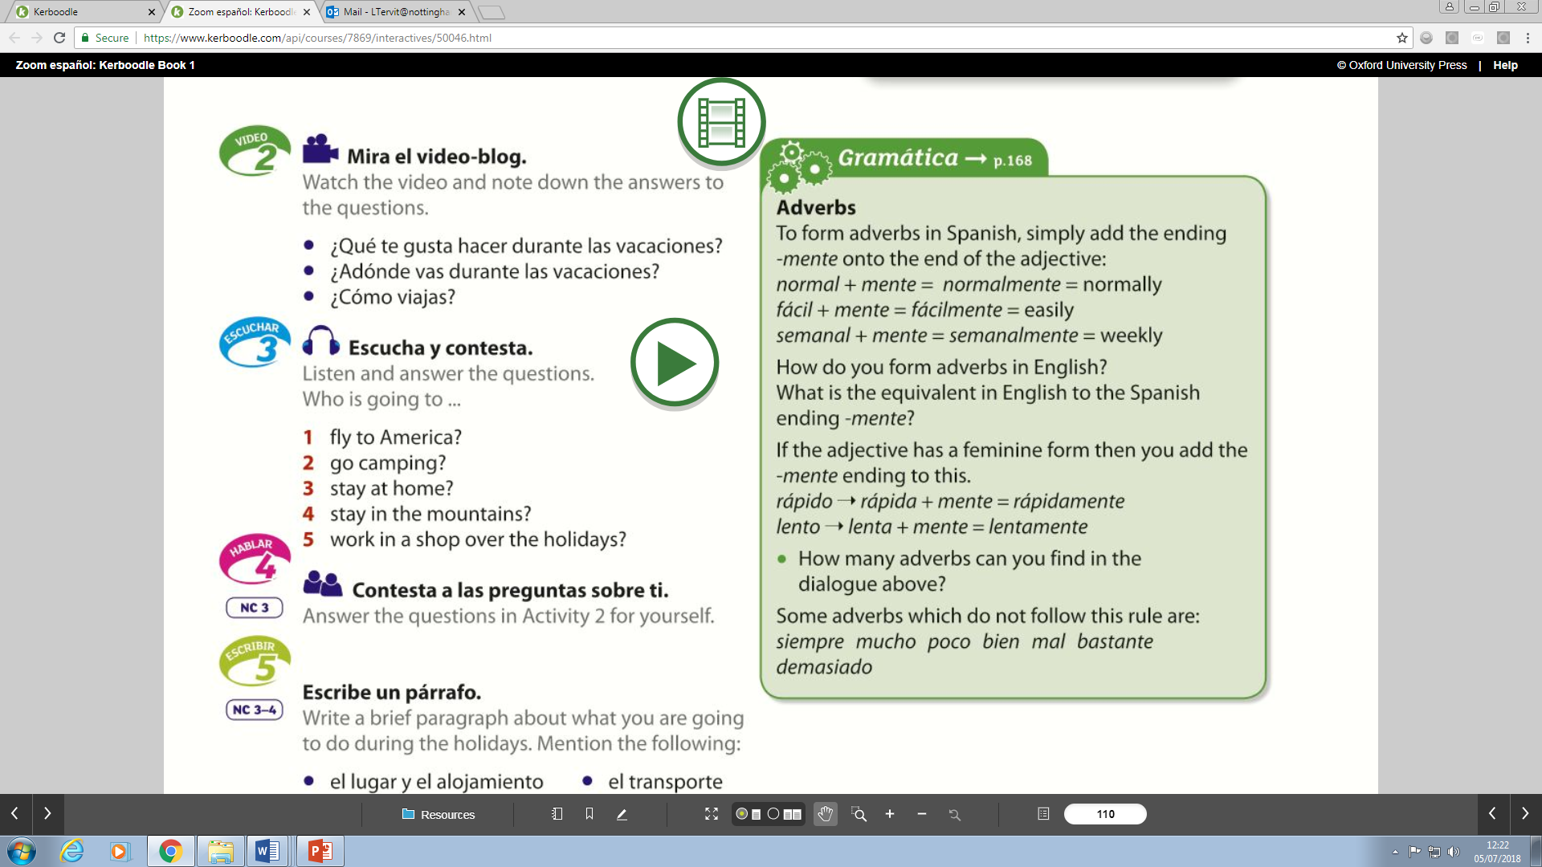

Year 7 Homework
Knowledge Organiser
Summer Term 1
Spanish
Past tense: https://quizlet.com/_68efo0
Es tan fácil como… = it is as easy as
Es mejor que = it is better than
Es peor que = it is worse than
Es lo / la mejor = it is the best (masc / fem)
Es lo / la peor = it is the worst (masc / fem)
Día de los muertos (Mexican tradition)
Flamenco (Spanish dance)

Slide 6
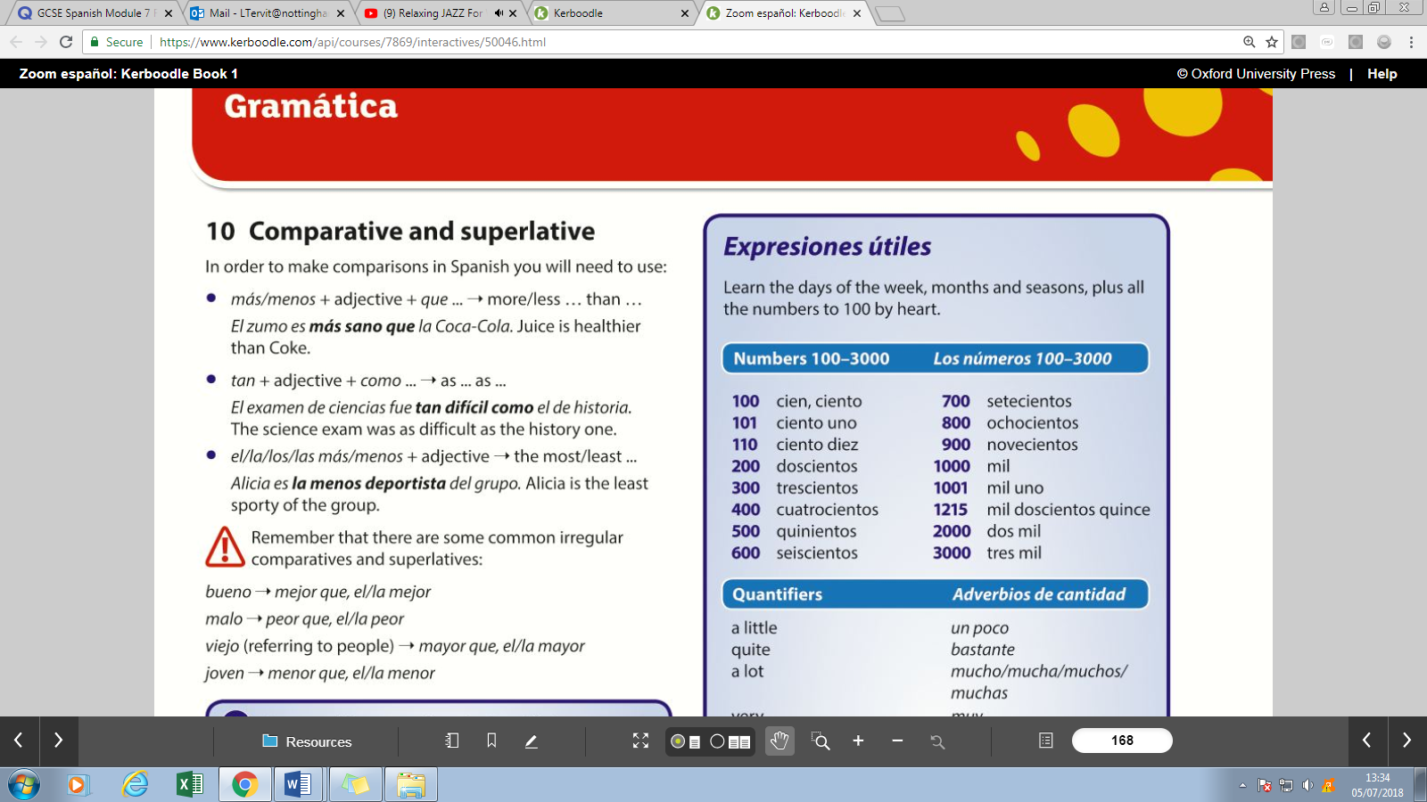
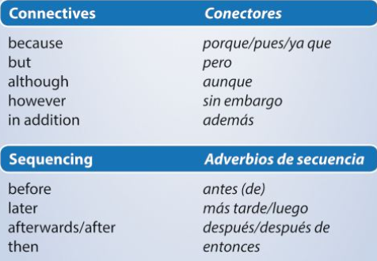
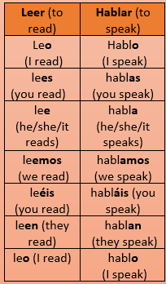
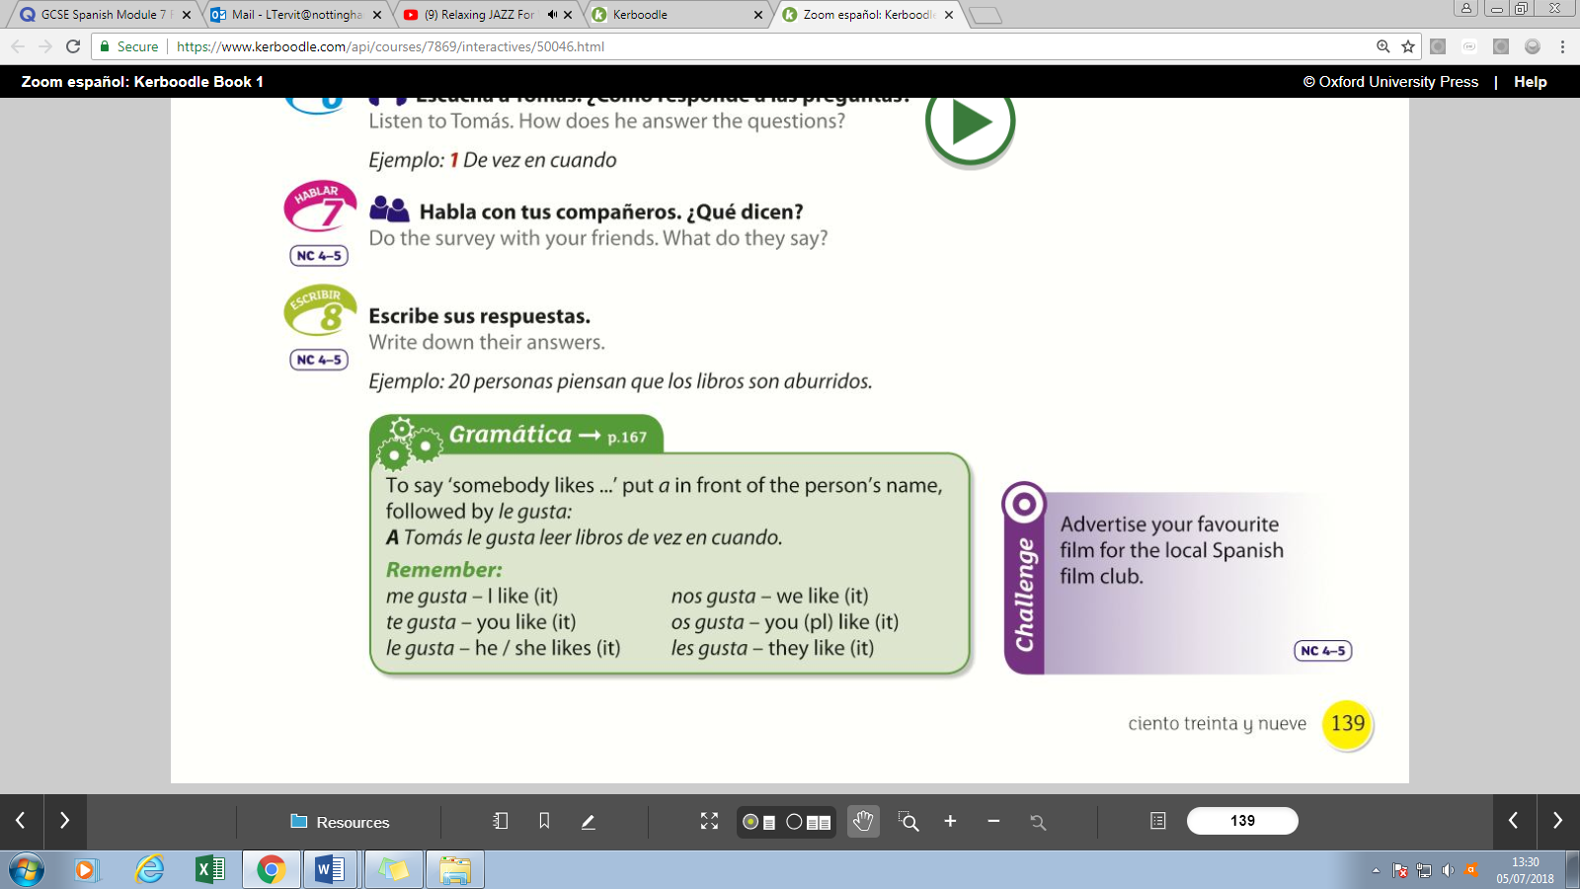
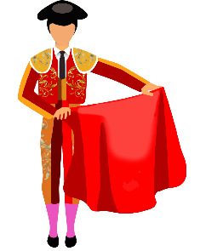
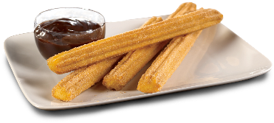
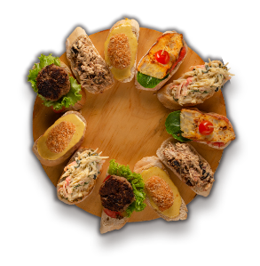

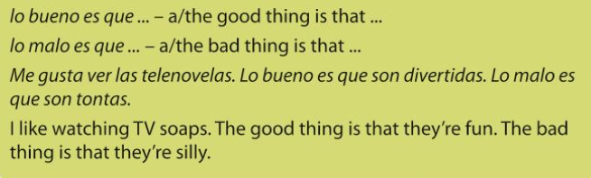
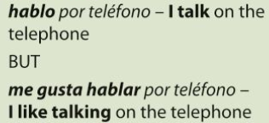
Year 7 Homework
Knowledge Organiser
Summer Term 2
Spanish
Opinions: https://quizlet.com/_6rvitz
Corridas de toro (Bullfighting)
Churros con chocolate (Spanish food)
Mi(s) = my
Tu(s) = your
Su(s) his / her / their
Nuestro/a(s) = our
Vuestro/a(s) = your
Tapas (Spanish food)

