Slide 1
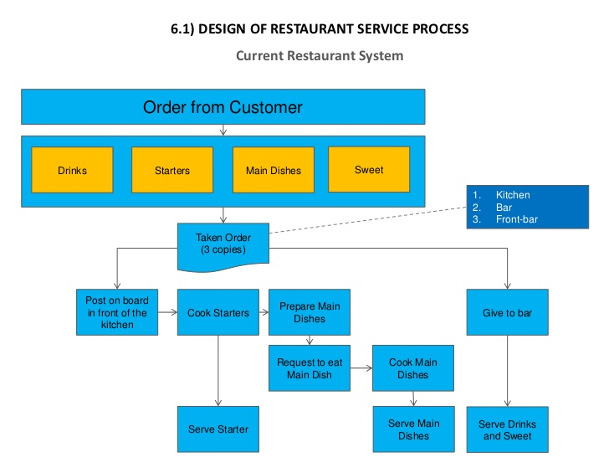
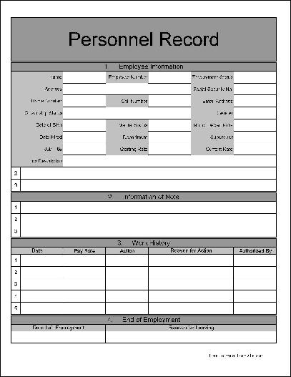
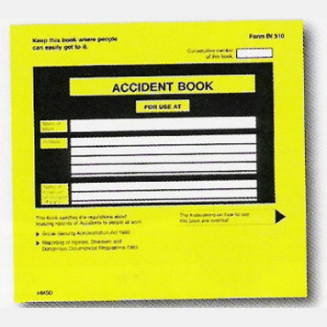
AC 2.1 The operation of the kitchen
Key Term | Definition
Covers | Customer food orders that are sent to the kitchen
FIFO | First in, first out- using food stocks in rotation
Workflow | The way food passes through the kitchen from delivery to the dining room
Personnel records
Hours worked
Personal details
Wages
Taxation
National insurance
Training
Accidents
Staff rotas and timetables
Protective clothing
Hat
Protects from smoke and oil
Stop hair falling in food
Chef whites
Protects body from burns and heat from ovens
Make a clean barrier between the chef and food
Absorbs sweat
Shoes
-Strong, well- fitting, slip resistant with toe protectors and low heels
Health and safety, hygiene
Fire certificate
Staff training records
Accident book
Food hygiene checks
Cleaning checks
First aid records

