Slide 1
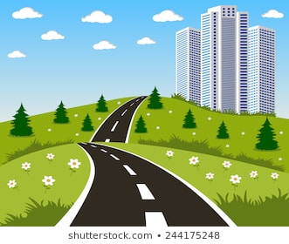
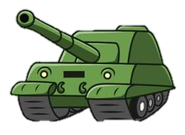
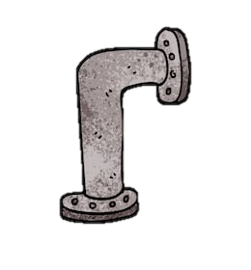
NAZI ECONOMIC POLICY: 1933-1936
Nazi Economic Aims
Public Work Schemes
Hitler and the Nazi Party had won the people’s vote 1933 by promising “Work and Bread”. This means that Nazi economic policy would be central to their overall mission. As such, the Nazis had the following goals:
To mine more natural resources, in order to boost industry
Create Public Work (building) schemes that put young men back into work
Re-armament (the creation of weapons)
Conscription – enrolling all unemployed young men into the army (this would then be extended to all young men closer to WW2)
In 1933, Hitler ordered the creation of a new network of autobahns or motorways to link major towns and cities. This helped to connect rural inhabitents to the cities and ship important goods and materials to where they were needed. This project employed 100,000 men and by 1938 they had created 3800 km of highway. Similarly, the Nazis also invested in building new schools and hospitals, and this in turn gave people jobs.
Re-armament Programme
The Nazis also focused on re-armament – the building up of its armed forces. Hitler was determined to make Germany a powerful military country again. The party invested heavily in tanks, battleships, fighter planes and guns. This created thousands of jobs in the factories. Huge government contracts also pleased the rich factory owners
Schacht’s Economic Plan, 1933-1936
Conscription
Invisible Unemployment
In 1933, Hitler appointed a respected banker named Hjalmer Schacht to the position of Minister of Economics. Schacht understood that in order to re-arm Germany and prepare for a potential war, they would need to mine more raw materials, such as iron, rubber and wood. Germany did not have enough natural resources and so Schacht formed trade deals with countries in South America and south-east Europe so that the raw materials can be brought to Germany and turned into goods. This worked well at first – production in factories increased and unemployment fell. However, Hitler felt these changes were coming too slowly and so sacked Schacht in 1936.
Hitler also introduced conscription. From 1935, all males aged between 18 and 25 years were forced to join the armed forces for two years. Within five years, the army grew from 100,000 to 1,4 million, thus providing more jobs.
By 1939, the Nazis claimed that nobody was unemployed in Germany! However, that is due to the fact that women, Jews, and other ethnic minority groups were sacked from their jobs struck off the employment register. This is ‘Invisible Unemployment’

Slide 2
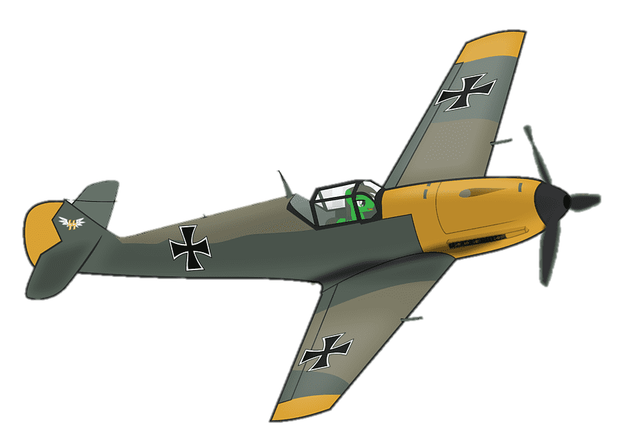
NAZI ECONOMIC POLICY: 1936-1945
Goering’s Four Year Plan
Total War
In 1936, Hitler replaced the economic expert, Schacht, with one of his closest and most loyal supporters, Hermann Goering. Goering was a war veteran and he was tasked with preparing the economy for the next war. Georing arrived at the ‘Four Year Plan’ which mapped out the increase in military production in preparation for the coming war. This increased the steel, textile and ship-building industries. High targets were set and achieved in the steel and explosives industry; however, these targets were not met in oil production. Production of consumer goods, such as fridges and cars, significantly decreased.
For the first two years of the war, 1939-1940, the Nazis were winning. However, after America joined the war and the Nazi invasion of Russia backfires in 1941, the war turns against the Nazis.
In 1942, the Nazis introduced ‘Total War’ – this was when all production was focused on the creation of weapons or the production of food for the soldiers. Everything that did not contribute to the war was closed – this included beer halls, post delivery service, and even sweet shops! Factories stayed open for longer hours, but because the men were drafted to fight, women had to return to work. They also relied on the slave labour of 7 million prisoners of war.
Self-sufficiency
Rationing
One of the main reasons why Germany lost WWI was because the British naval blockade cut Germany off from the rest of the world and, because they lacked sufficient natural resources, this led to reduced production and, eventually, the starvation of the German people. Goering was determined that this would not happen again, and so introduced a policy of ‘self-sufficiency’ so that Germany could stop trading with other countries and still survive. This resulted in German scientists arriving at imaginative solutions to Germany’s limited resources problem – e.g. making petrol from coal, artificial wool from pulped wood. Goering famously said in a speech: “Would you rather have butter or guns? Shall we bring in lard, or iron? I tell you, guns make us powerful. Butter only makes us fat.”
During WW2, the German people were subjected to rationing of all food and essential goods. This became more severe as the war went on. For example, hot water was limited to twice a week and people were limited to one egg per week and essential items like soap and toilet paper were rarities. This led to people creating alternatives – such as stewed pine needles for soap.
Bombing
From 1942 onwards, the Americans and British bombed German cites, such as Berlin, Hamburg and Dresden. This resulted in no electricity, water or transport in this cities. It also resulted in a high number of refugees, who had lost their homes. Bombs caused flooding and gas explosions and people lived in constant fear. Morale plummeted.

Slide 3
NAZI ECONOMIC POLICY: DID WORKERS LIVES’ IMPROVE?
Did wages increase?
Strength through Joy (KDF)
The Nazi economic policies generated work in factories and in construction work, such as the building of motorways, hospitals and schools. Wages did not increase in the first few years but at least people were in work, which was better than nothing. For many workers, ‘real wages’ increased (the amount of money a person had left over once they had paid for essential living costs) but this was only if they increased the number of hours that they worked.
This scheme introduced leisure activities for workers. This was because the Nazis believed that if the workers had things to enjoy in their spare time they would be more productive at work. It was a reward scheme, which offered cheap holidays, cinema and theatre trips, and tickets to football matches. You could even win a cruise! However, statistics show that most workers only won low-cost prizes, such as the opportunity to go hiking in the countryside. The issuing of cinema tickets was also a propaganda opportunity for Nazi films.
The DAF: German Labour Front
The Beauty of Labour
When Hitler passed the Enabling Act in March, 1933, he disbanded all trade unions, who would normally represent workers on issues such as wages and working conditions. The trade unions were replaced by the German Labour Front (the DAF), which promised to protect their rights. All workers had to join. The DAF did provide two schemes that benefited the workers. These were called ‘The Beauty of Labour’ and ‘Strength through Joy’
The Beauty of Labour aimed to improve the working environment; they installed better lighting and safety equipment in factories. They also constructed sports facilities and canteens. However, the workers were often asked to build these facilities in their own time – e.g. some were asked to construct a swimming pool in their holidays.
Support for Farmers
The Volkswagon Scheme
Farmers had been important supporters of Hitler and they made up 30% of the population. Many had suffered heavily under the Great Depression. Therefore, Hitler fixed grain prices so that they were guaranteed to sell their grain at a certain price. This was good for farmers but not for factory workers, who had to pay more for essential food. He also cut taxes for them and assured them that they would not lose their land if they fell into hardship. He also introduced laws to stop farmers from dividing land between children, to ensure they were kept intact, which was welcomed by some, but not others whose younger children were forced to the cities in search of work.
This was a payment scheme so that all workers could pay a contribution of their wages toward buying ‘the people’s car’, something which most ordinary people would normally not be able to afford. The scheme was very popular. However, by the late 1930s, the factories that produced the Volkswagon ceased production and diverted attention to military production. The people who had paid into the scheme did not get their money back!

Slide 4
NAZI ECONOMIC POLICY: DID WORKERS LIVES’ IMPROVE?
Did wages increase?
Strength through Joy (KDF)
The Nazi economic policies generated work in factories and in construction work, such as the building of motorways, hospitals and schools. Wages did not increase in the first few years but at least people were in work, which was better than nothing. For many workers, ‘real wages’ increased (the amount of money a person had left over once they had paid for essential living costs) but this was only if they increased the number of hours that they worked.
This scheme introduced leisure activities for workers. This was because the Nazis believed that if the workers had things to enjoy in their spare time they would be more productive at work. It was a reward scheme, which offered cheap holidays, cinema and theatre trips, and tickets to football matches. You could even win a cruise! However, statistics show that most workers only won low-cost prizes, such as the opportunity to go hiking in the countryside. The issuing of cinema tickets was also a propaganda opportunity for Nazi films.
The DAF: German Labour Front
The Beauty of Labour
When Hitler passed the Enabling Act in March, 1933, he disbanded all trade unions, who would normally represent workers on issues such as wages and working conditions. The trade unions were replaced by the German Labour Front (the DAF), which promised to protect their rights. All workers had to join. The DAF did provide two schemes that benefited the workers. These were called ‘The Beauty of Labour’ and ‘Strength through Joy’
The Beauty of Labour aimed to improve the working environment; they installed better lighting and safety equipment in factories. They also constructed sports facilities and canteens. However, the workers were often asked to build these facilities in their own time – e.g. some were asked to construct a swimming pool in their holidays.
Support for Farmers
The Volkswagon Scheme
Farmers had been important supporters of Hitler and they made up 30% of the population. Many had suffered heavily under the Great Depression. Therefore, Hitler fixed grain prices so that they were guaranteed to sell their grain at a certain price. This was good for farmers but not for factory workers, who had to pay more for essential food. He also cut taxes for them and assured them that they would not lose their land if they fell into hardship. He also introduced laws to stop farmers from dividing land between children, to ensure they were kept intact, which was welcomed by some, but not others whose younger children were forced to the cities in search of work.
This was a payment scheme so that all workers could pay a contribution of their wages toward buying ‘the people’s car’, something which most ordinary people would normally not be able to afford. The scheme was very popular. However, by the late 1930s, the factories that produced the Volkswagon ceased production and diverted attention to military production. The people who had paid into the scheme did not get their money back!

Slide 5
NAZI SOCIAL POLICY: THE YOUTH
Why were the youth important?
Universities
Hitler believed that if young people were raised with the ideologies and views of the Nazi Party, they would become loyal supporters in adulthood. This comes from the philosophy of, “You give me a boy to the age of seven, and I will give you the man.” By your late teens, you have already shaped your moral and political beliefs, based upon the environment in which you were raised. Therefore, if the Nazi Party could control that environment then, in the long term, the German people were more likely to conform to their political beliefs.
Universities under Weimar Germany had been places that embraced cultural change, modern values and freedom of speech. Therefore, they were a likely ‘hot bed’ for opposition to the Nazi regime. To deal with this problem, the Nazis sacked any University lecturer from an ethnic minority background or who was known to have opposing political views. This resulted in 3000 lecturers losing their jobs – accounting for 15% of lecturers. Many were forced into exile. University courses, too, had to change – for example, a Physics lecturer could not teach about Einstein’s theory of relativity because Einstein was Jewish.
The School Curriculum
Hitler Youth Groups
Hitler also believed it was important to control a young person’s free time and leisure pursuits, and this is why he set up Hitler Youth groups. For boys, this was focused on preparation for war using outdoor pursuits, marches and exhibitions (long hikes). For girls, this was about preparing them for motherhood, such as how to keep fit (fitness was linked to fertility), and domestic sciences (e.g. cooking and mending clothes)
Hitler used the school system to ‘brainwash’ young people toward Nazi ideology. For example, he replaced Science lessons with ‘Eugenics’ which were effectively Race Studies, to teach young people about the superiority of the Aryan (German) Race compared to the inferiority of Jews, Slavs and other ethnic minorities. This resulted in young people believing they were better than other races, and explains why so few younger people spoke out against the persecution during WWI. Similarly, History focused on big German military victories and used the ‘Stab in the Back’ theory to show how ordinary German soldiers were betrayed during WWI by the new Weimar government.
Teachers had to swear an oath of loyalty to the Nazi regime and to comply with Nazi ideology. They were responsible for identifying bright students who could become future Nazi leaders, who were then sent to ‘Napolas’ (special academies).
Boys
Girls
GROUP | AGE | ACTIVITIES
Little Fellows | 6-10 | Scouting, camp fire songs, recited pledges
Young Folk | 10-14 | War games, physical activities, marches, shooting practice, camping.
Hitler Youth | 14-18 | Pre-military preparation, including specialisms, longer marching exhibitions to build stamina
GROUP | AGE | ACTIVITIES
Young Girls’ League | 10-14 | Summer camps, lessons in folklore and singing, exercise
League of German Maidens | 14-18 | One year working on the land, physical exercise, and ‘domestic science’
Faith and Beauty | 18-21 | Continued preparation for marriage and worked in the community.

Slide 6
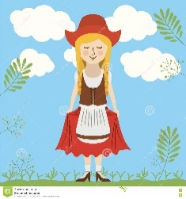
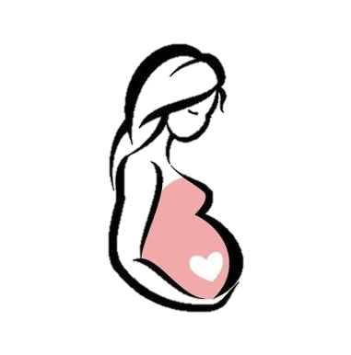
NAZI SOCIAL POLICY: WOMEN
The Ideal Woman
Rewards and Incentives
During the 1920s, women enjoyed new freedoms and rights, such as the right to vote and the opportunity to enter a professional career, such as teaching or law, after attending University. However, this changed dramatically when the Nazis came to power. This is because the Nazis believed that a woman’s place was within the home, and their main purpose was to bear and raise children for the Nazi state. Hitler came up with the ‘three Ks’ slogan to define a woman’s role: Kinder, Kirche, and Kuche (children, church and cooking).
Furthermore, during the Weimar years, women were allowed to go out to night clubs, smoke, drink, wear make-up, cut their hair short and wear revealing and fashionable dresses. This was not allowed under the Nazi regime. Women were expected to keep their hair long, wear traditional clothing, and keep their faces plain. Night clubs were certainly out of the question!
The Nazis introduced schemes to provide women with an incentive to have a large family. The government gave loans to newly married couples to encourage them to start a family straight away. On the birth of their first child, the loan was reduced by 25% and if they had a second, it was reduced to 50%, and so on, so that if they had four children then they would not need to pay back the whole loan. There was also the Motherhood Medal for producing a large family and this was celebrated every year at a ceremony held on Hitler’s mother’s birthday (12th August) with the Gold Cross Medal awarded to mothers who had eight children.
Lebensborn
Lebensborn translates as ‘fount of life’ and was established in 1935. The objective was to increase the birth rate of ‘pure’ Aryan children. It was a place where young, unmarried women could become impregnated by an SS soldier. They were then sent to a birth house where they were given the best anti-natal care for the delivery of their child. By the end of WWII, it is estimated that 8,000 children were born and, once WWII began, the SS officers would kidnap young children with desirable genetics from neighbouring eastern European countries with the aim of ‘Germanising’ them to be raised in the Nazi regime.
The Ideal Mother
All women who worked for the government (e.g. civil servants and teachers) were sacked. This was because the Nazis believed that women could not raise a large family if they had a career. Contraception and abortion was illegal. The Nazis set up the German Women’s League where representatives would travel across the country to provide advice to women on cooking, child care, and healthy eating. This was designed to create an elite group of ‘perfect’ Nazi women. By March 1939, 1.7 million women had attended one of these ‘motherhood’ courses.
Success?
The birth rate in Germany did increase. In 1933, approximately 970,000 children were born; in 1939, 1.4 million were born. However, this slowed down significantly once WWII began because the young men were sent to war and women had to go back to work in order to feed their families.

Slide 7
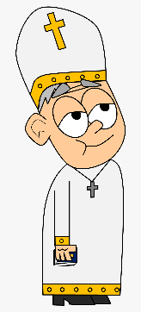
NAZI SOCIAL POLICY: THE CHURCH
The Importance of Christianity
The Reich Church
Most people in Germany were Christian. Around one third of Christians were Catholic (2 million people) and two thirds were Protestant (4 million people). Those who were Protestant belonged to various denominations, so would worship in different ways. Hitler knew that he would have to tread carefully with how he dealt with the Church, as it had its own ideologies and teachings, many of which contradicted the policies of the Nazi Party; for example, the teachings from the Sermon on the Mount where Jesus preaches about looking after the weak and poor, to forgive those who wrong you, and to love thy neighbour.
The Protestant Church had many denominations, and so Hitler
decided to unify them under a single ‘Reich Church’. They were labelled as German Christians, and their leader, Ludwig Muller, was made a Reich Bishop. Many Protestants joined the Reich Church because they agreed with some of Hitler’s moral views, relating to traditional family values. They would attend services wearing Nazi uniform and used the slogan, “the swastika on our chests and the Cross in our hearts.” The Reich Church would also use Mein Kampf as the most important source of moral authority. This was a clever way of assimilating Christianity into the Nazi regime and to indoctrinate the congregation to trust in Nazi ideals over those found in the bible.
The Catholic Church
Hitler saw the Catholic Church as a big threat. This is because German Catholics have an allegiance to the Pope in Rome. In 1933, Hitler set up a Concordat, which is a meeting between the Pope and a political leader; they decided not to interfere with each other’s affairs. However, Hitler only saw this as a temporary measure, in those crucial early years when he needed to secure his power. The Nazis soon began to harass leading members of the Catholic Church in Germany and closed down all Catholic schools and youth groups. The pope retaliated in 1937 with a publication called ‘Burning Anxiety’ where he condemned Hitler for being ‘hostile to Christ and his Church’. However, it had little impact on ordinary German Catholics. One exception was Archbishop Galen, who openly spoke out against the Nazi racial policies and euthanasia programme. He was placed under house arrest as a result.
The Confessional Church
Some Christians were brave enough to oppose the Reich Church,
since it went completely against their ethics. A new Protestant group emerged called the Confessional Church, led by Pastor Martin Niemoller, who encouraged fellows pastors to openly criticise the Nazi regime. In retaliation, the Nazis arrested 800 Confessional Church pastors and sent them to concentration camps, including Niemoller.
Pacifists
Some Christian groups were pacifists, meaning they did not believe in war; this made them a threat to the Nazi regime. As a result, approximately one third of Jehovah Witnesses were killed in the concentration camps and other pacifist groups, such as the Salvation Army, were forced into exile.

Slide 8
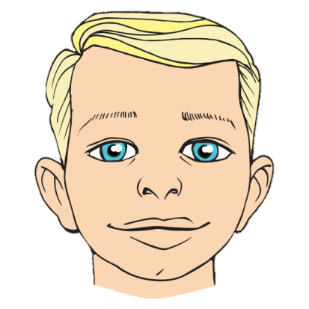
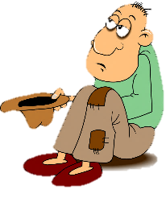
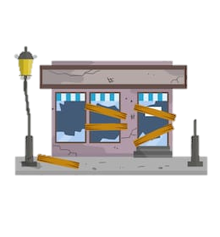
NAZI SOCIAL POLICY: PERSECUTION OF MINORITIES
Hitler’s Views on Race
Persecution of Jews in 1930s
Hitler built up the Nazi Party on the belief that the German race was the ‘master race’ – he called this Aryan. The desirable physical qualities of the Aryan race was fair-skinned, blonde hair and blue eyes, with an athletic physique. Hitler believed the ‘strong must dominate and not blend with the weak’ and all inter-race marriages were made illegal. Germany had a number of ethnic minority groups, such as the Slavs, gypsy Romanies, and the Jews. At first, the Nazis used segregation laws to keep these groups separated from the rest of the German population, however, these measures grew more severe throughout the 1930s, paving the way for the Holocaust during WWII.
Date | Event
Mar-Apr, 1933 | All Jewish lawyers, judges and teachers were sacked
Sept, 1933 | Race studies introduced in schools
Jan, 1934 | All Jewish shops marked with the Star of David
Sept, 1935 | The Nuremberg Laws, when Jews lost their citizenship and the right to vote or marry non-Jews
Aug, 1938 | All male Jews had to add ‘Israel’ to their first name and all female Jews had to add ‘Sara’
Nov, 1938 | Jewish children were banned from school
Apr, 1939 | Jews can be evited from their homes for no reason
The Undesirables
Hitler believed that all Germans should work to build up the German Reich. However, he felt there were some Germans who were incapable of work, and these were known as the ‘Undesirables’. These included:
Half a million tramps, beggars and alcoholics who were sent to concentration camps and worked to death
Pacifists and others with strong religious beliefs who refused to join the army or swear allegiance to Hitler
Around 350,000 physically and mentally disabled people were forcibly sterilised so that they could not pass on their ‘deformities’ to the next generation.
From 1939, the Nazis introduced their euthanasia programme where 200,000 Germans, including 5,000 children, were killed in special ‘nursing homes’.
Kristallnacht (Night of Broken Glass)
On 9th November, 1938, there was a seemingly spontaneous outbreak of violence against the Jews by ordinary German people. It was triggered by the assassination of a German diplomat by a Polish Jew. During the night, ordinary Germans (accompanied by Nazi soldiers in ordinary clothes) smashed in Jewish shops and synagogues. 100 Jews were killed and 20,000 sent to concentration camps. Nazi Propaganda Minister, Goebells, used this as a great opportunity to broadcast the event across the media, showing how the German people clearly hated the Jews. After this event, the persecuted took its first step to genocide.

Slide 9
THE FINAL SOLUTION
The Impact of the War
The Wannsee Conference, 1942
Hitler had always had a passionate hatred for the Jews, which he had written about in Mein Kampf. During the 1930s, the Nazi Party had steadily increased their anti-Semitic (anti-Jewish) policies and many had escaped persecution. However, when WWII broke out, the Nazis invaded these countries and the actions against the Jews became more extreme. As the war progressed, more Jews found themselves trapped under Nazi occupation, including 3 million Jews in Poland and 2.7 million in Western Russia. Hitler became obsessed with the Jewish problem and firmly believed that unless they were exterminated, Germany would lose the war.
The war began to turn against the Germans once the Americans joined in 1942. Leading Nazi generals believed the extermination of the Jews was not happening fast enough. They met in Wannsee just outside Berlin and they decided upon the Final Solution. This was where they would divide Jews into those they would work to death in the concentration camps and those too physically weak for hard labour who would be sent straight to the gas chambers. Six major death camps were built; many, like Auschwitz, were built close to pre-existing concentration camps. By the end of WWII, 6 million Jews had been killed, alongside 11 million others from ethnic minorities or for political opposition.
Ghettoisation
The Nazis created ghettos in cities that had a high Jewish population, such as Warsaw, Krakow and Lodz. The Jews were rounded up and placed in these ghettos, which were then bricked up and heavily guarded. Food was scarce and disease spread easily amongst the overcrowded, appalling living conditions. In the largest ghetto of Warsaw, 300,000 people were killed by either being shot or gassed, and a further 92,000 killed of starvation and hunger.
Public Reaction
It was not just the SS officers who implemented the Holocaust. It also required ordinary people, such as railway workers who put the Jews onto the trains, and office clerks to run the concentration camps. The use of the Nazi police state, such as the Gestapo, made it difficult for ordinary people to have the courage to speak out. The use of propaganda also de-humanised the Jewish population, making it easier to turn a blind eye. This meant many people became bystanders – they knew about the Holocaust, but condoned it or were too fearful to act. The Allied powers also knew about the death camps; however, for strategic and practical reasons, it was difficult to do anything about it.
The Einsatzgruppen
During the invasion of Poland and Russia, the Nazis used execution squads called Einsatzgruppen. These squads went into the countryside to villages with a known Jewish population, round up the Jews, and perform mass shootings. An estimated 1.3 million Jews were killed in this way. The worst case was in Babi Yar in the Ukraine, where 34,000 Jews were killed in two days.

Slide 10
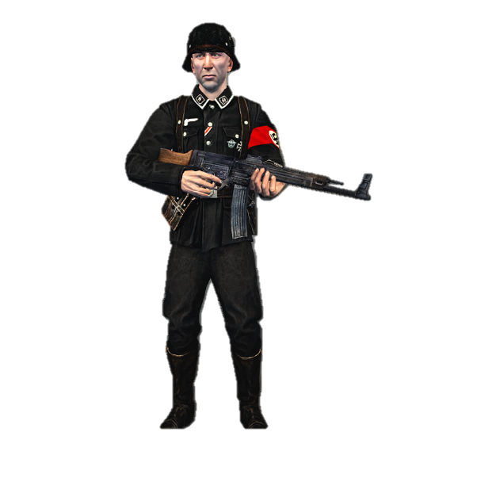
THE NAZI POLICE STATE: USE OF FEAR
Fear vs Adoration
Heinrich Himmler
Hitler seemed hugely popular with the German people during the 1930s. He had ‘celebrity status’ with large crowds following his every movement and many heralding him as a Christ-like figure who had saved Germany from ruin. However, it is hard to tell how genuine this popularity was due to the Nazi Police State. This is the mechanisms that the Nazis put into place to prevent political opposition and to flush out anyone who dared to speak out. This meant that many pretended to support Hitler to avoid persecution.
Heinrich Himmler was a leading member of the Nazi Party who was put in charge of the police state. This included the normal police force, the judicial system, the SS and the Gestapo. This gave him tremendous power.
The SS
The SS – or ‘blackshirts’ – were originally set up in 1925 as Hitler’s personal body guards. However, after they took an essential part in the Night of the
Long Knives in 1934 by executing 400 members of the SA, they were given a much more powerful and important role within the Nazi Police state. All members of the SS had to portray the perfect ‘Aryan’ traits, being athletically fit, and be completely loyal to Hitler. The SS were divided into three sections:
The SD focused on ‘security’ – they had the powers to arrest people, search homes and seize property. They were even responsible for spying on key members of the Nazi Party itself.
The Waffen SS: an elite group within the army
The Death’s Head Units – ran the concentration and death camps
Concentration Camps
The first concentration camp was set up in Dachau, in March 1933 – only one month after Hitler became chancellor. Its first prisoners were Communists and members of the SPD who opposed the Nazi regime, arrested under the Enabling Act. However, once Hitler became Fuhrer of Germany, more concentration camps opened for ‘enemies of the state’ so that they could be ‘corrected’ in their political views. Later, minority groups such as Jews and gypsies were sent too. In the concentration camps, the inmates were given hard labour in appalling conditions.
The Gestapo
The Gestapo were the Secret Police. They wore ordinary clothes and spied on ordinary citizens within each town across Germany. If they thought someone
was a threat they would tap their phones and intercept their mail. They also had the power to arrest without a warrant and even use methods of torture.
The Gestapo relied upon a network of informants, who were unpaid, and would report on their neighbours for even moaning about Nazi policies! Children were encouraged to report their teachers or parents. This fed an environment of paranoia, where many would report on their neighbours for fear that they would be reported by them if not!
Police and Law Courts
The regular police continued their normal jobs, but they turned a blind eye to crimes committed by Nazis. All leadership positions were given to Nazis. The Nazis also took over the law courts and replaced all judges with loyal Nazis. They introduced new laws to enforce the police state, such as the death penalty given to telling an anti-Hitler joke and, during WW2, listening to a foreign radio station.

Slide 11
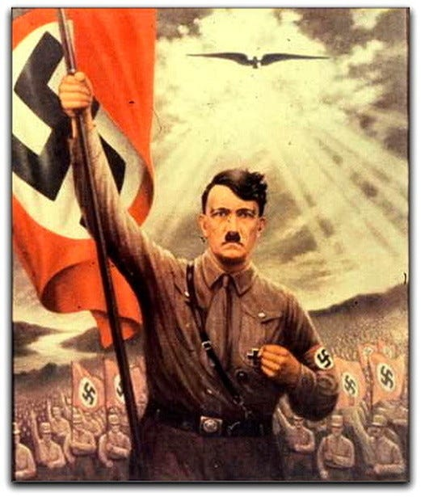
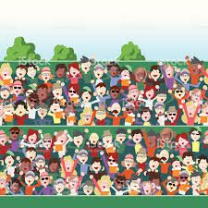
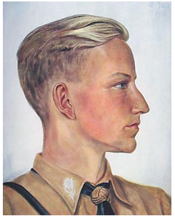
THE NAZI POLICE STATE: USE OF PROPAGANDA
What is propaganda?
Newspapers
The word ‘propaganda’ comes from the word ‘propagate’ which means to spread information and ideas. It is now associated with the spread of political ideas with the purpose of winning support from the public. The Nazi Party used propaganda from the 1920s onwards to win people over to their message. Joseph Goebells, who became the Minister of Enlightenment and Propaganda, was the mastermind behind all the methods of propaganda in Nazi Germany
Only pro-Nazi messages were shown in newspapers. They were used to portray positive stories about what the Nazi party were achieving – such as their work on autobahns, or the re-building of the Nazi army – and to portray negative messages about the ‘enemies of the state’ – such as conspiracies about the Jews.
Mass Rallies
What is censorship?
Hitler was a very skilled orator – he was a passionate and eloquent public speaker. Therefore, the Nazis used mass rallies to stir up mass support for their ideas. They used spectacular parades to celebrate Nazi achievements. These included fireworks, bands and performances. Special arenas – like the Nuremberg rally stadium – were specially built to house up to half a million people. This helped to bring people together in a sense of wonder and amazement for the Nazi party. Imagine it a bit like Glastonbury, with Hitler as the headline act!
Goebells knew that he could not just rely on propaganda; he would have to censor anything that would put across an alternative point of view. This was when other messages were removed from the public eye, including newspapers, films and even jokes. From March to October 1933, the Nazis underwent a book burning campaign, which destroyed millions of books that contained ideas that were opposed to Nazi views. On 10th May 1933, 40,000 people gathered at a single book burning to destroy over 250,000 books.
The Arts & Radio
Propaganda Messages
The Nazi ideology became part of the culture, and this was reflected in music, art, theatre, cinema and radio. Theatre plays and cinemas were used as propaganda to convey Nazi messages. All writers were told to include pro-Nazi ideas in their plays or films. The Nazis also controlled all radio stations and mass produced cheap radios so that everyone could hear the Nazi message in their homes. Loud speakers were placed in streets, cafes and factories and when Hitler made a speech, everyone was expected to stop what they’re doing to listen. In a time before television, the radio and cinemas were the best opportunity for the Nazis to convey their message.
Propaganda had to evoke powerful emotions. In posters, Goebells used short messages and powerful images. These could be negative – such as the horrific images of Jews that made them look greedy, rich, and ‘leeches’ of the German state. This turned them into scapegoats for Germany’s recent misfortunes. The emotions could also be positive – such as the use of a traditional family scene, using the Aryan super-race, and showing how the family could prosper again under the Nazis.

Slide 12
THE NAZI POLICE STATE: USE OF ARTS AND CULTURE
The Chamber of Culture
Literature
Joseph Goebells established an organisation called the Chamber of Culture, which was used to regulate the arts. All musicians, writers and performers had to become a member and those who refused were not allowed to work. The purpose of this organisation was to ensure that all the arts had the same ‘message’ which was pro-Nazi, and so in this sense, it was a part of Goebells’ large propaganda machine.
Goebells created a list of banned books that were considered ‘un-German’ or written by Jewish authors. These were removed from shops and libraries, and many were destroyed in the book burning of 1933. Unsurprisingly, Mein Kampf became a bestseller. Around 2500 writers and playwrights were forced into exile between 1933-1945.
Art & Design
The Cinema
The modern and abstract art that had been popular under Weimar,
such as work of Otto Dix, was now banned. Hitler called this type of art ‘degenerate’. In 1936, the Nazis publically burnt 5000 art pieces they disapproved of. The Nazi style of art was simple and classical; it had to portray a clear message to the masses, and had to show healthy, heroic and ‘pure’ Germans, as well as heroic images of Hitler, sometimes appearing as a Christ-like figure.
During Weimar Germany, the ‘Bauhaus’ movement had become an important architectural movement that designed simple, practical designs. Hitler hated this. Instead, he preferred classical architecture for his new rally stadiums and buildings – he often emulated the Roman style as this represented power.
Goebells knew the importance of cinema, which had emerged as a new art form during the Roaring 20s. The Nazi Party invested in film makers who were supporters of their regime, such as Alfred Hugenborg. Goebells would read every script before the cast were allowed to start filming to ensure a pro-Nazi message. For example, the German soldier was always the hero and the Jews were the villains. He would also ensure that there was a short broadcast of Nazi achievements before the screening of every film.
Music
All music had to be either German or Austrian. This included famous classical composers such as Bach, Beethoven and Mozart, as well as classical folk songs. Swing and jazz music, which had become popular under Weimar, was now banned. This is because it originated in African-American culture.
Berlin Olympics, 1936
Due to Nazi beliefs in the ‘Aryan Master Race’ health and fitness were incredibly important and PE became an important subject on the school curriculum. The 1936 Olympics in Berlin was Hitler’s best opportunity to show the world how amazing the Aryan race were – it worked, the public were hugely enthusiastic and the Germans topped the medal chart. However, there was a scandal when black American runner, Jesse Owens, won gold and Hitler refused to be part of the ceremony. He apparently said of the black competitors, “their physiques were stronger than those of civilized whites and hence should be excluded from future games.” This did little to convince the international community of superiority of the Aryan race!
Theatre
During the Nazi’s rise to power, they set up a group called the Militant League for German Culture which attacked popular theatre under the Weimar government, such as the popular Threepenny Opera by Jewish playwright, Kurt Weill. The Nazis ruled that theatre should only focus on German history. Cabaret clubs were also banned.

Slide 13
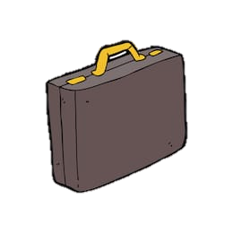
RESISTANCE & OPPOSITION TO NAZI RULE
Passive Resistance
Religious Opposition
It is difficult to measure how many people grumbled about the Nazi party policies within the privacy of their homes. Grumbling and moaning, or even telling anti-Nazi jokes, was illegal in public. So many people kept quiet. One way that people showed opposition was through passive resistance – this is when someone refused to do something, such as the Nazi salute in public or donate money to Hitler Youth members who called at people’s houses, to show their disapproval. These individuals ran the risk of their non-compliance becoming known by the local Gestapo.
Though most people were religious, only a few key religious figures were brave enough to take a stand. This includes Martin Niemoller – pastor of the Confessional Church – who was sent to a concentration camp for
preaching anti-Nazi messages; and the Catholic Archbishop Galen, who spoke out against the Nazi euthanasia and racial policies – who was placed under house arrest. Miraculously, both survived the Nazi regime!
Assassination Attempts
Youth Opposition
There were approximately 50 attempts to assassinate Hitler, often by individuals but sometimes by organisations. One significant group was the Kreisau Circle, which consisted of university professors, army generals and aristocrats, who were shocked by the brutality of the Nazi State. Another was the Beck-Goerdeler Group (named after the leaders) who tried to convince foreign governments to ‘remove’ Hitler and made three assassination attempts in 1944, including the July Plot.
Many teenagers enjoyed being part of the Hitler Youth and
became some of Hitler’s most vocal supporters after years of indoctrination. However, there was a minority who resented the strict Nazi rules and who realised that the way they were treating minority groups was morally wrong. The White Rose Group, for example, were a group of students from Munich University who handed out anti-Nazi leaflets and put up posters and graffiti. There were also banned youth groups who had their own counter-culture, such as the Edelweiss Pirates, who would dress in a more western style, smoke, drink and listen to Jazz music. They were even known for beating up members of the Hitler Youth. However, these groups were too small and spread out across the country. It was too easy to identify the ringleaders. The leaders of the White Rose Group, Hans and Sophie Scholl, were caught by a worker at the University, who informed the local Gestapo. They were then executed by guillotine to set an example for others.
The July Bomb Plot, 1944
This was the most significant attempt on Hitler’s life. By 1944, the war had turned against Germany, but Hitler and leading Nazis were turning to ever more reckless actions to try and turn the tide. A disillusioned army general called Stauffenberg decided to join the Beck-Goederdeler Group and agreed to detonate a bomb, since as a high-ranking army officer, he would be one of the rare few people allowed to meet Hitler. He hid the bomb in a briefcase and was able to detonate it, killing four men. However, he was only able to singe Hitler’s hair and burst his ear drum. Hitler was outraged and as a result, the Gestapo rounded up anyone who had even the most remote connection to the plot – 7,000 people were arrested and 4,800 were killed. Not all those executed were connected to the plot as the Gestapo used it as an opportunity to settle old scores, just showing how far the Police State had come by this point!

